Slide 1
CSE 161 – Design and Architecture of Computer Systems
The Pipelined CPU

Slide 2
performance issues
Longest delay determines clock period
Critical path: load instruction
Instruction memory → register file → ALU → data memory → register file
Not feasible to vary period for different instructions
Violates design principle
Making the common case fast
We will improve performance by pipelining

Slide 3
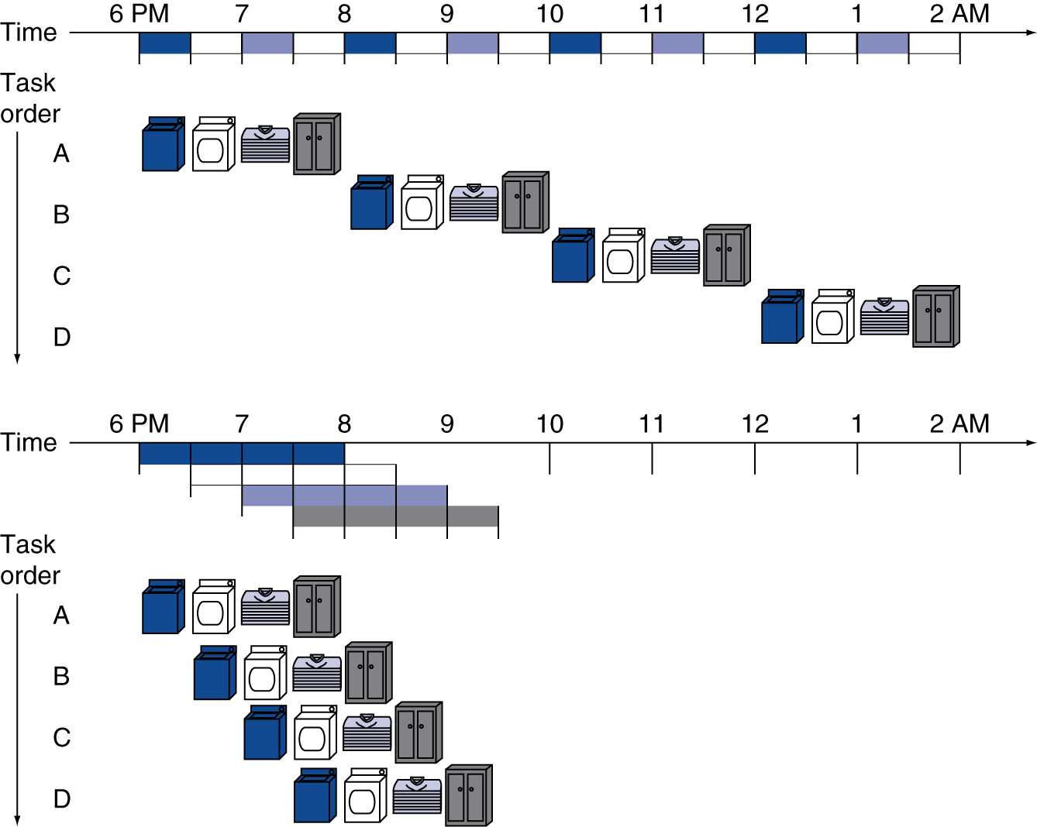

pipelining analysis
Pipelined laundry: overlapping execution
Parallelism improves performance
k stages pipeline; t time per stage;
n jobs
Non-pipelined time: T₁ = n.k.t
Pipelined time: T_{p} = (k + n – 1).t
Speedup = T₁/T_{p}
Four loads:
Speedup = 8/3.5 = 2.3
Non-stop:
Speedup = 2n/0.5n + 1.5 ≈ 4 = number of stages
This is an ideal case:
No job depends on a previous job
All jobs behave exactly the same
Not realistic.

Slide 4
MIPS pipeline
Five stages, one step per stage
IF: Instruction fetch from memory
ID: Instruction decode & register read
EX: Execute operation or calculate address
MEM: Access memory operand
WB: Write result back to register

Slide 5
pipeline performance
Assume time for stages is
100ps for register read or write
200ps for other stages
Compare pipelined datapath with single-cycle datapath
Instr | Instr fetch | Register read | ALU op | Memory access | Register write | Total time
lw | 200ps | 100 ps | 200ps | 200ps | 100 ps | 800ps
sw | 200ps | 100 ps | 200ps | 200ps |  | 700ps
R-format | 200ps | 100 ps | 200ps |  | 100 ps | 600ps
beq | 200ps | 100 ps | 200ps |  |  | 500ps

Slide 6
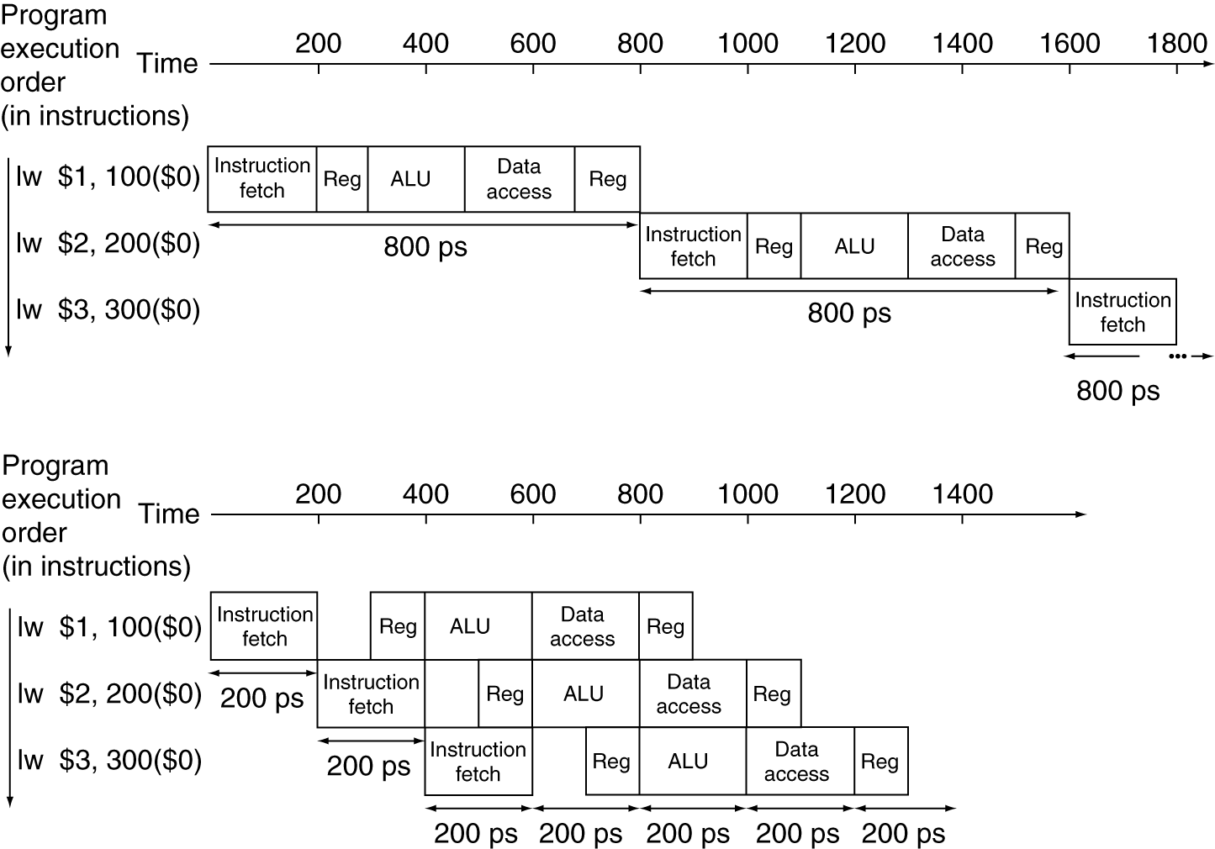
pipeline performance
Single-cycle (T_{c}= 800ps)
Pipelined (T_{c}= 200ps)

Slide 7
pipeline speedup
If all stages are balanced
i.e., all take the same time
If not balanced, speedup is less
Speedup due to increased throughput
Latency (time for each instruction) does not decrease

Slide 8
pipelining and ISA design
MIPS ISA designed for pipelining
All instructions are 32-bits
Easier to fetch and decode in one cycle
c.f. x86: 1- to 17-byte instructions
Few and regular instruction formats
Can decode and read registers in one step
Load/store addressing
Can calculate address in 3rd stage, access memory in 4th stage
Alignment of memory operands
Memory access takes only one cycle

Slide 9
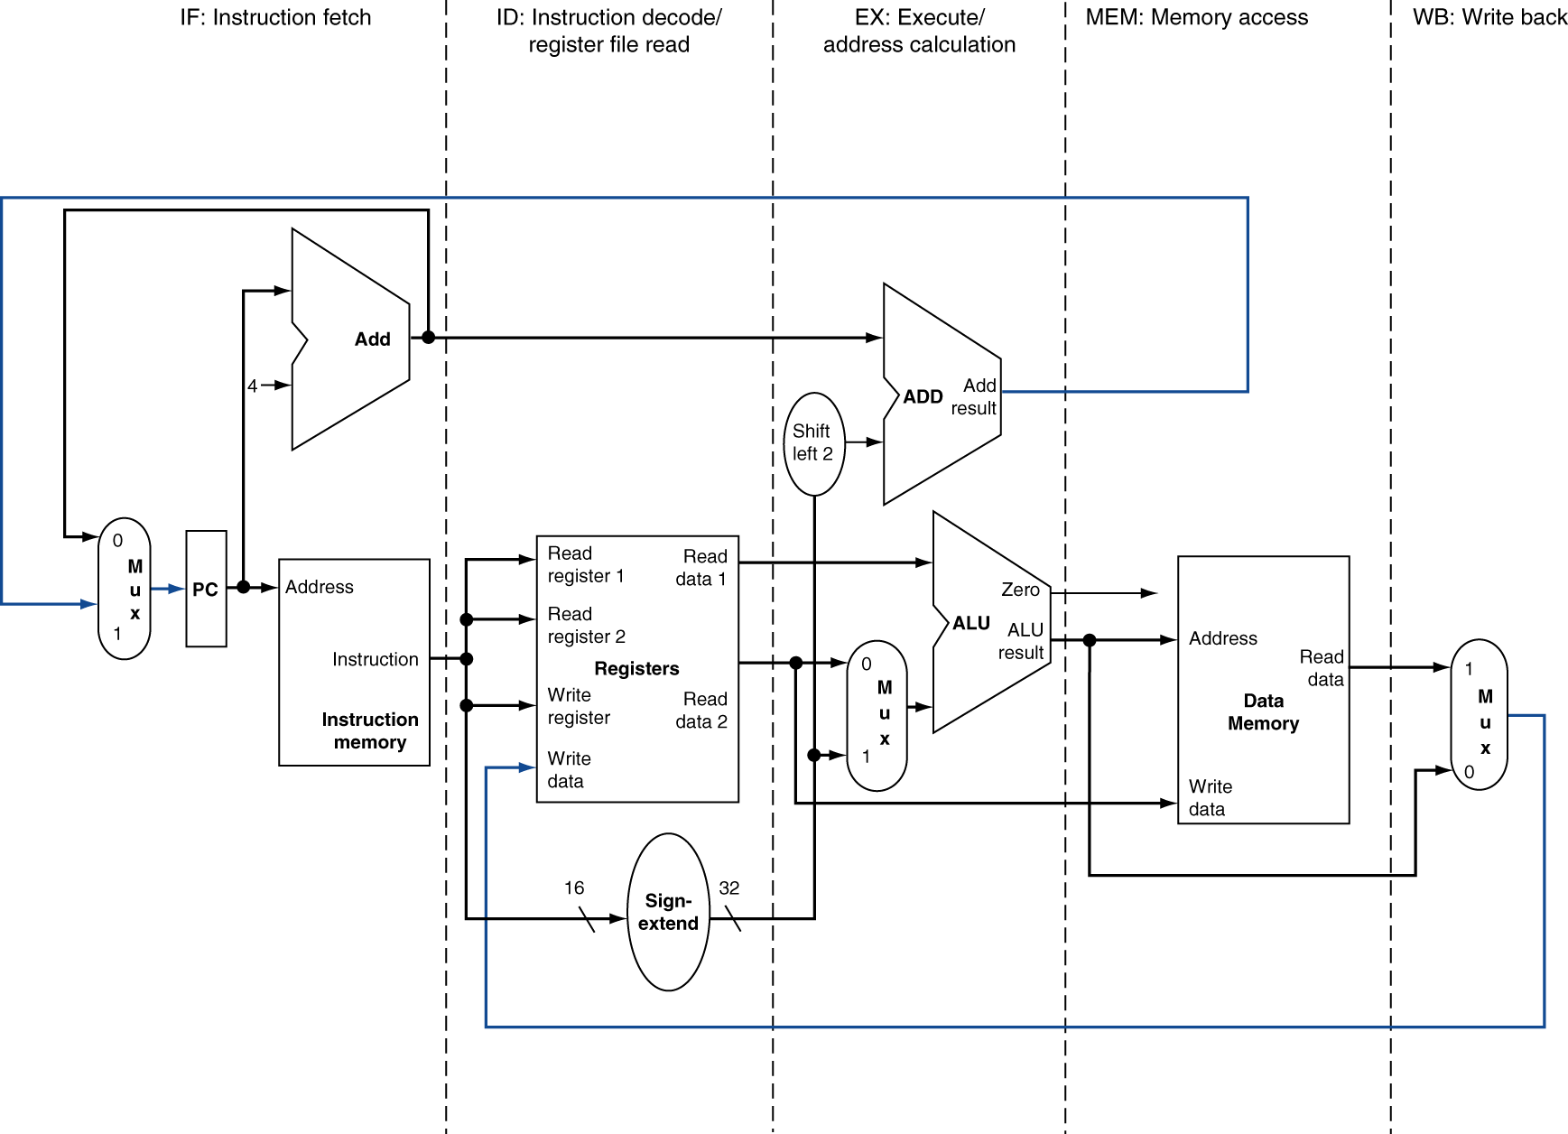
MIPS pipelined datapath
MEM
Right-to-left flow leads to hazards
WB

Slide 10
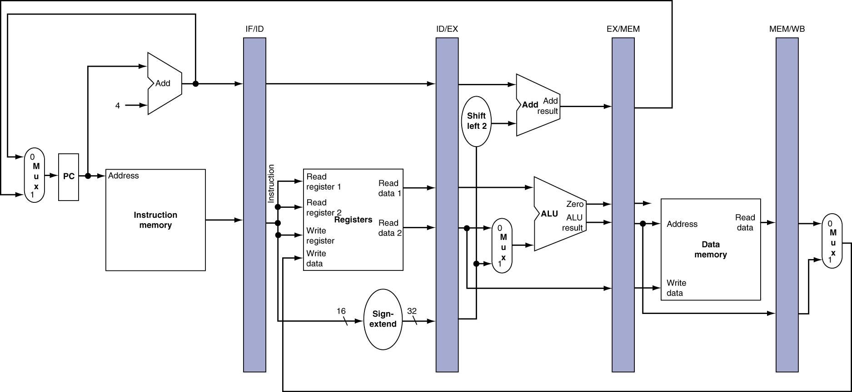
pipeline registers
Need registers between stages
To hold information produced in previous cycle

Slide 11
pipeline operation
Cycle-by-cycle flow of instructions through the pipelined datapath
“Single-clock-cycle” pipeline diagram
Shows pipeline usage in a single cycle
Highlight resources used
c.f. “multi-clock-cycle” diagram
Graph of operation over time
We’ll look at “single-clock-cycle” diagrams for load & store

Slide 12
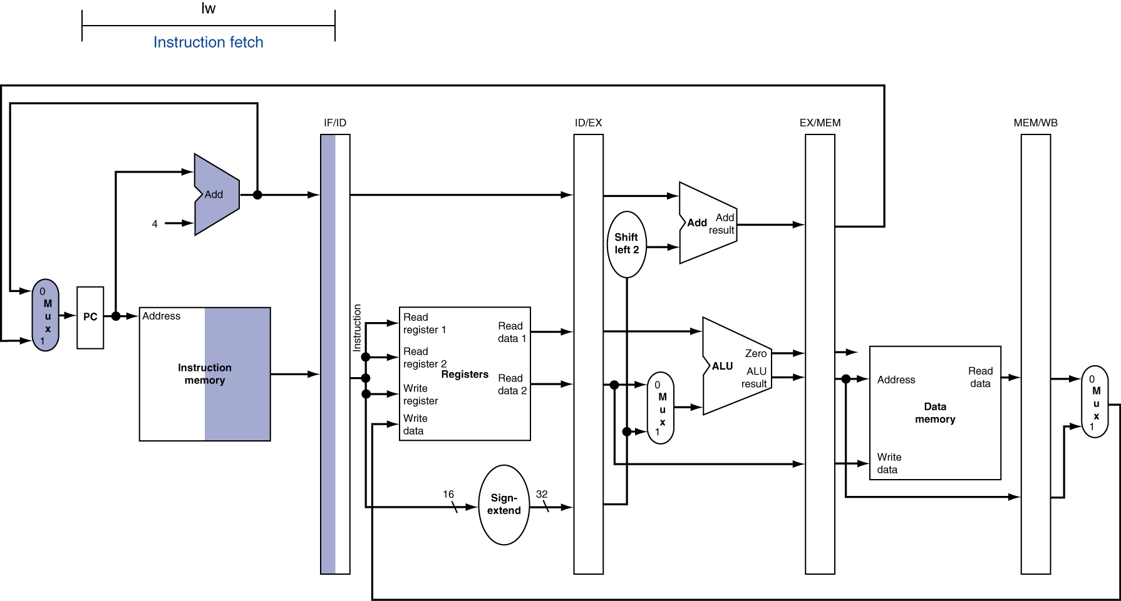
IF for Load, Store, …

Slide 13
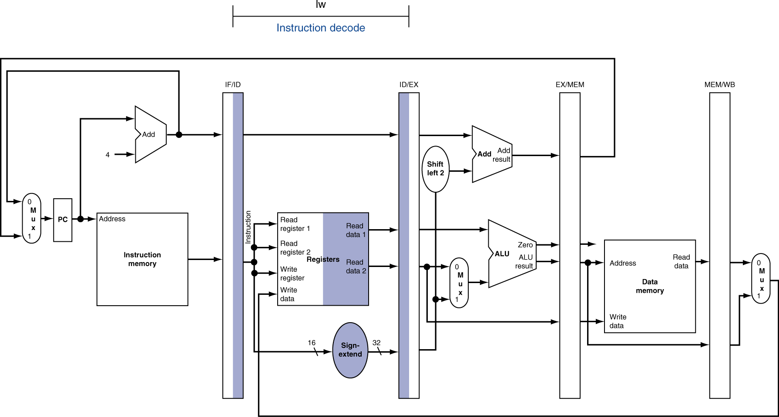
ID for Load, Store, …

Slide 14
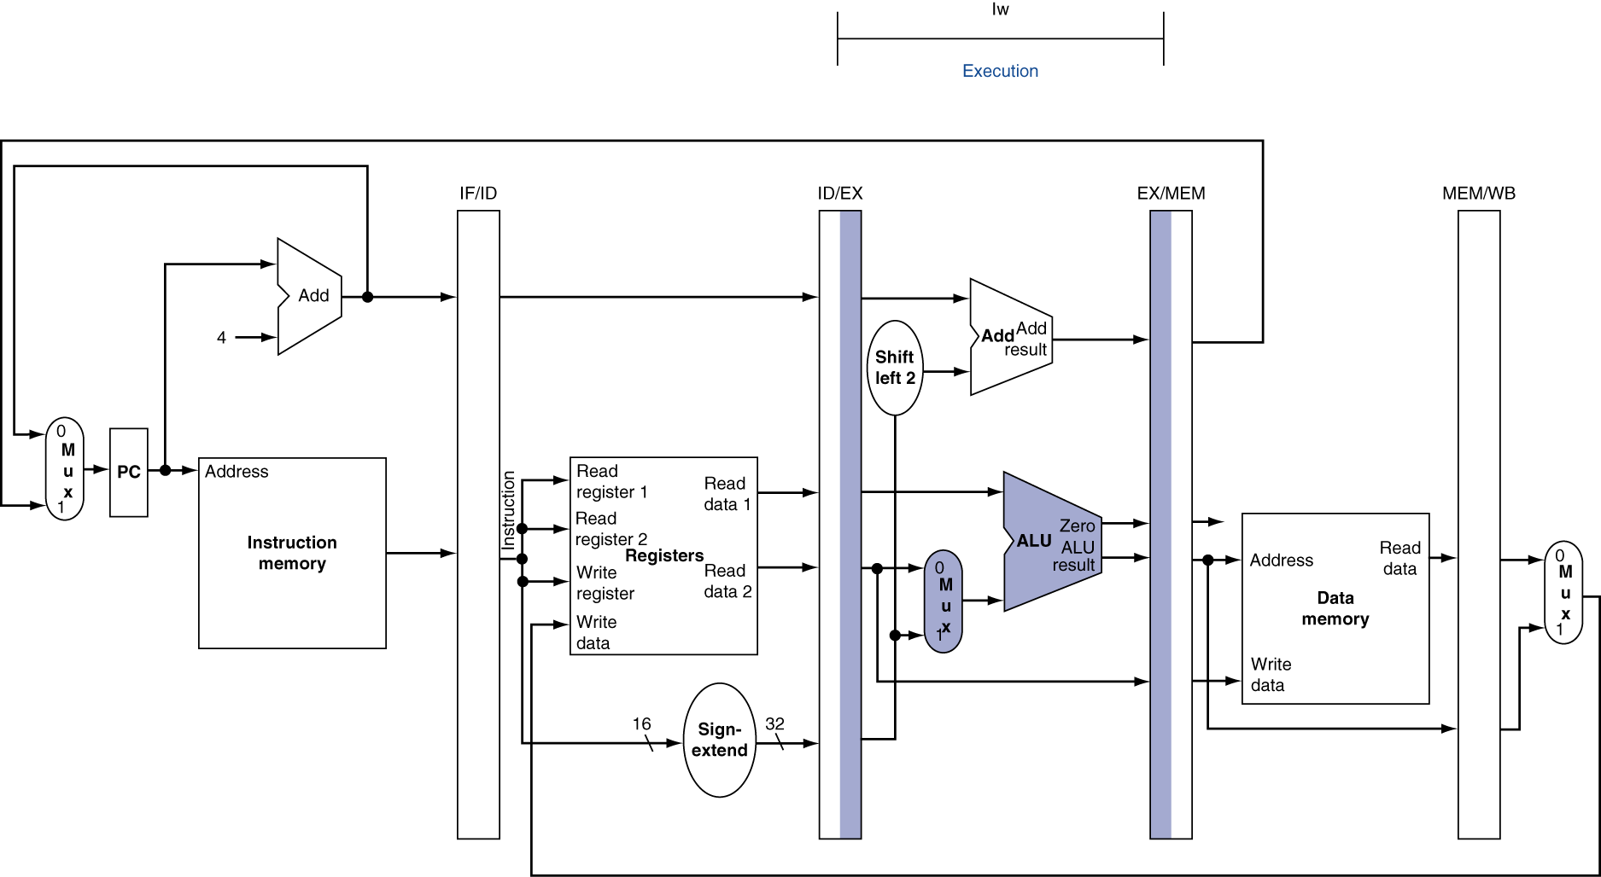
EX for Load

Slide 15
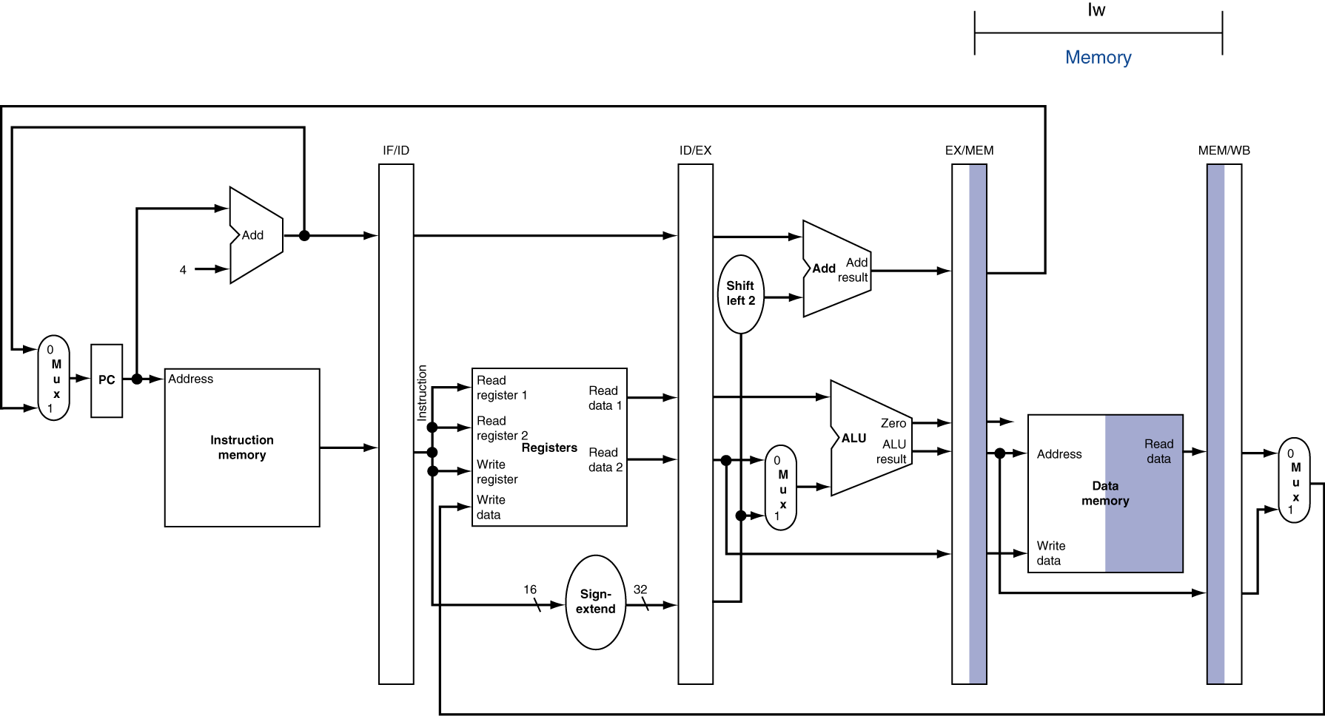
MEM for Load

Slide 16
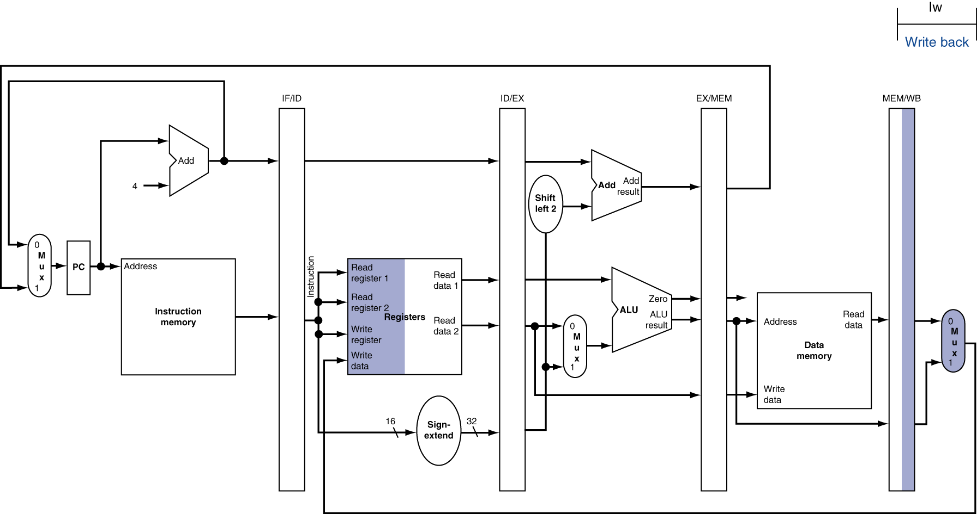
WB for Load
Wrong register number
Notes:
Rule: Each resource can only be used in one stage of the pipeline or it will create structural hazard

Slide 17
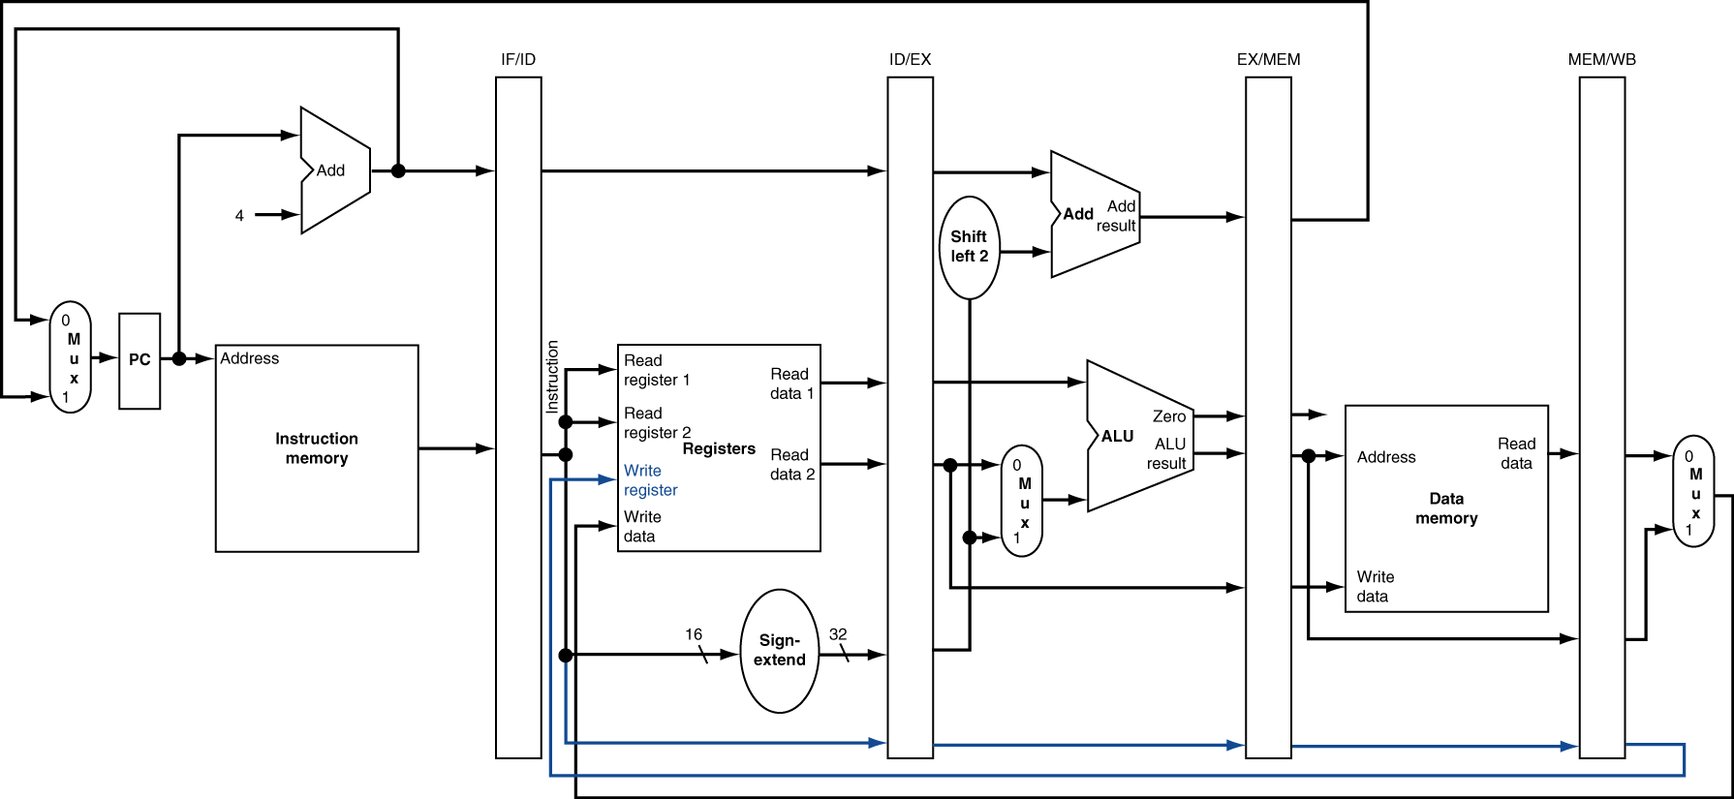
corrected datapath for load

Slide 18

EX for Store

Slide 19
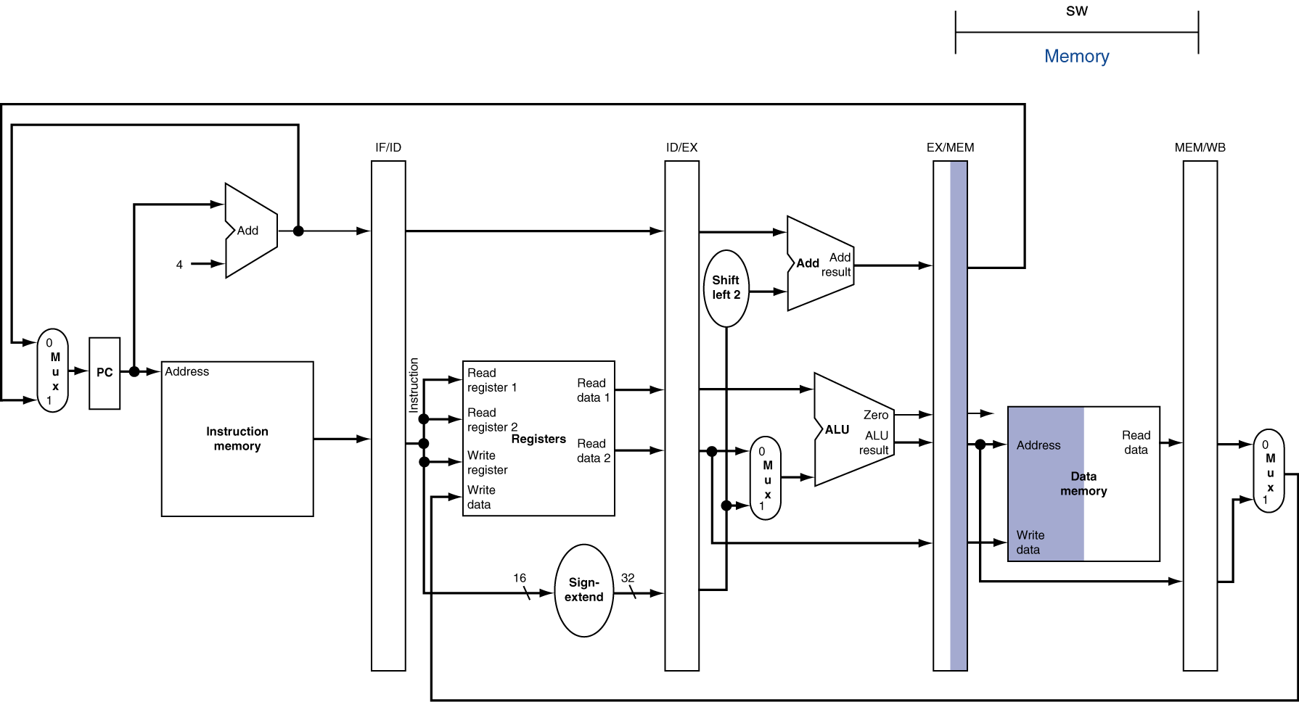
MEM for Store

Slide 20
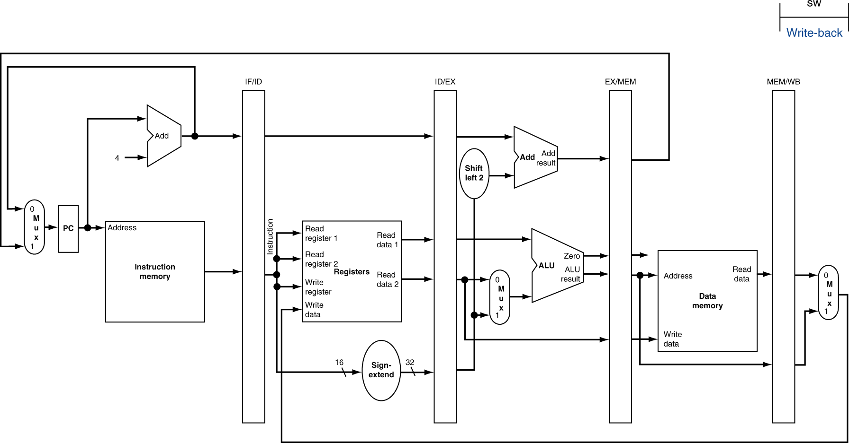
WB for Store

Slide 21
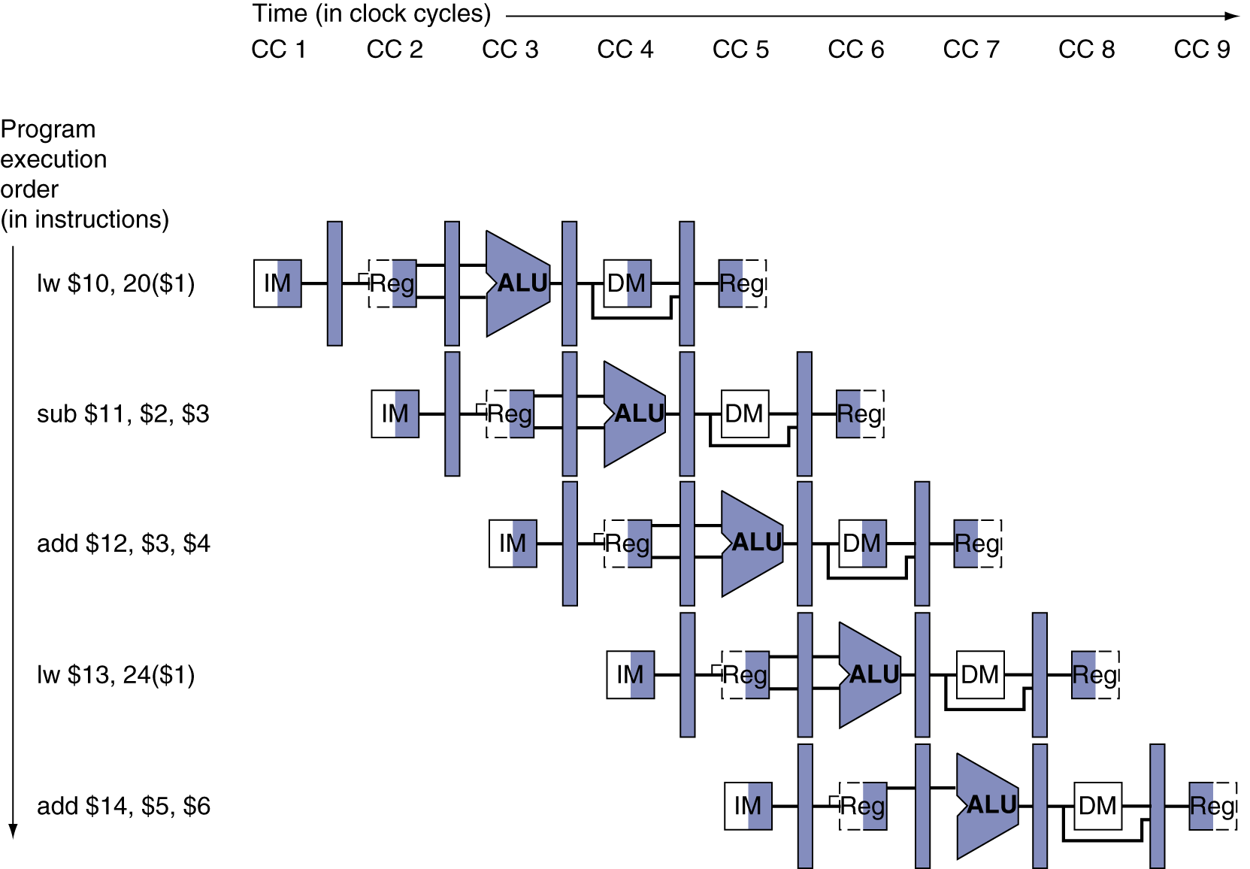
pipeline diagram
Form showing resource usage

Slide 22
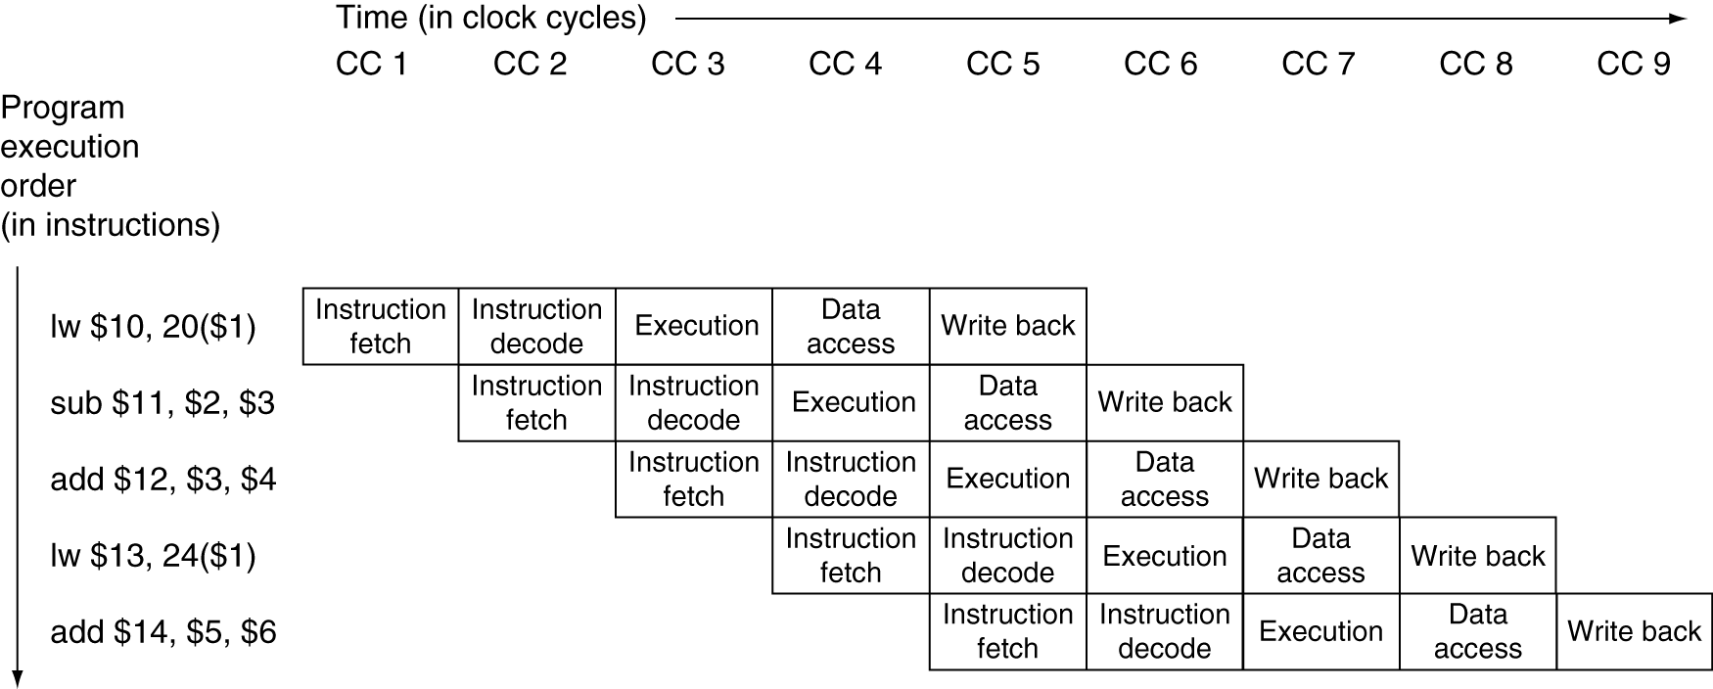
pipeline diagram
Traditional form

Slide 23
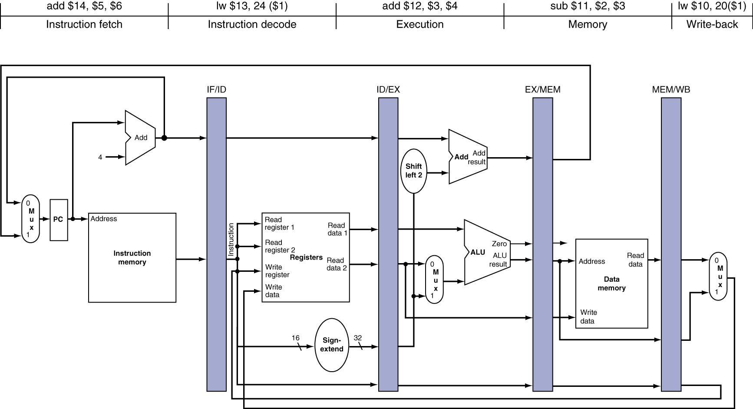
pipeline diagram
State of pipeline in a given cycle

Slide 24
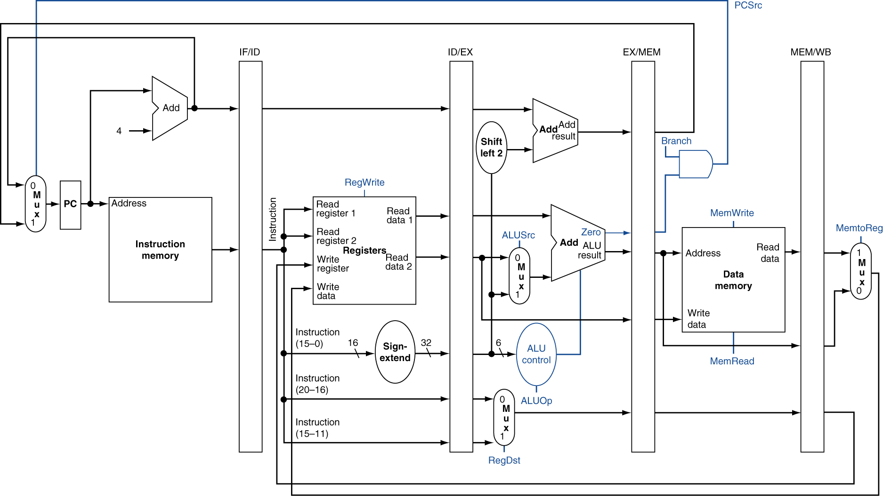
pipelined control (Simplified)

Slide 25
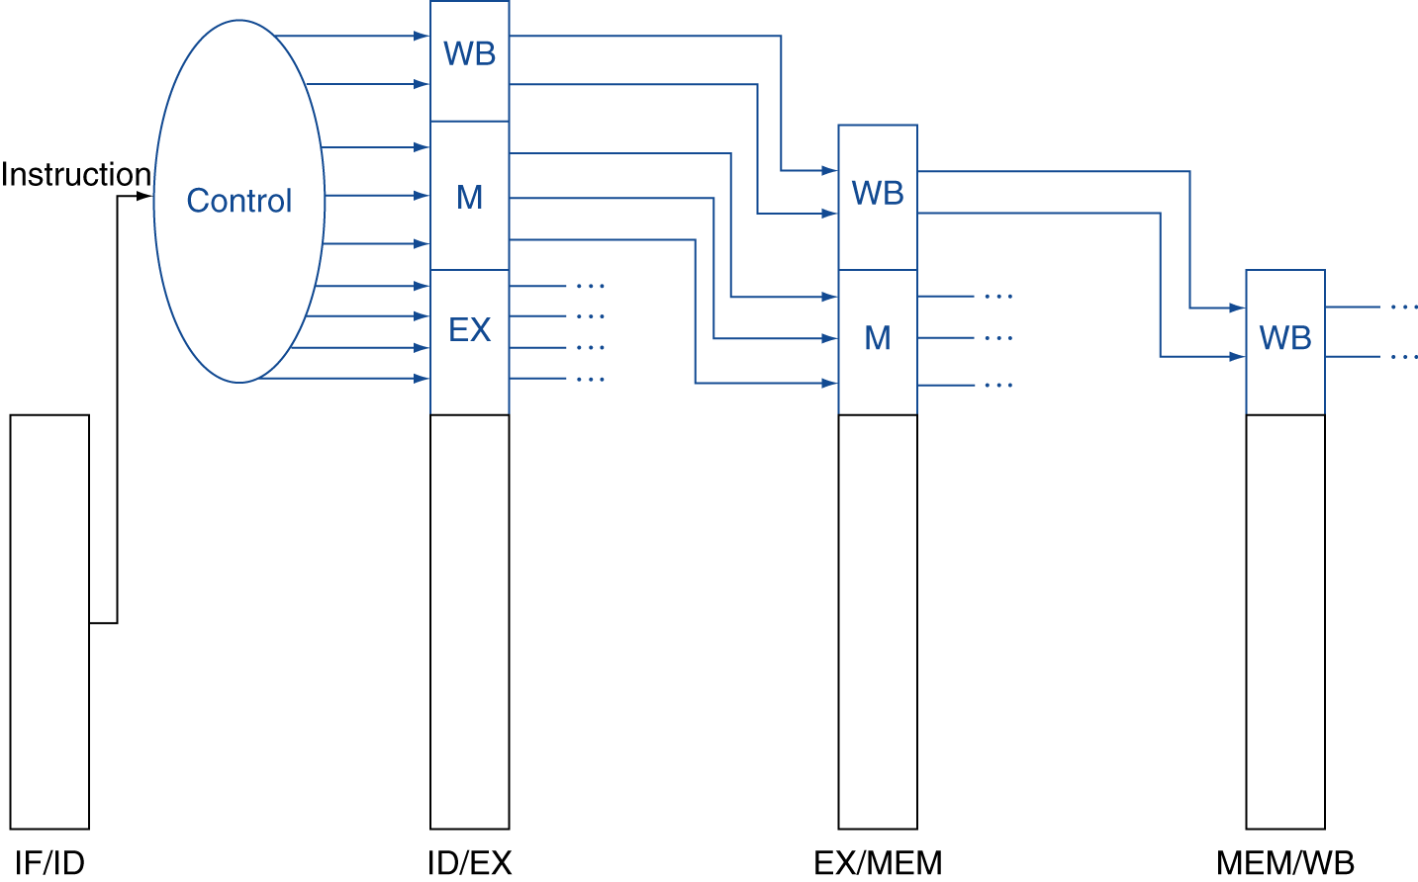
pipelined control
Control signals derived from instruction, in ID stage
As in single-cycle implementation

Slide 26
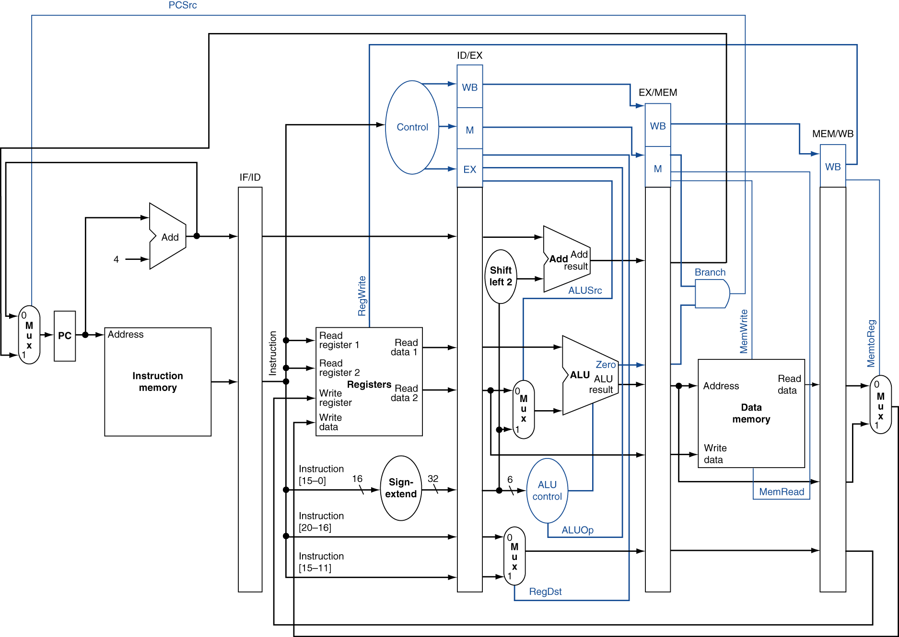
pipelined control

Slide 27
hazards
Situations that prevent starting the next instruction in the next cycle
Structure hazards
A required resource is busy: why we have I$ and D$
Data hazard
Need to wait for previous instruction to complete its data read/write
Control hazard
Deciding on control action depends on previous instruction

Slide 28
structure hazards
Conflict for use of a resource
In MIPS pipeline with a single memory
Load/store requires data access
Instruction fetch would have to stall for that cycle
Would cause a pipeline “bubble”
Hence, pipelined datapaths require separate instruction/data memories
Or separate instruction/data caches

Slide 29
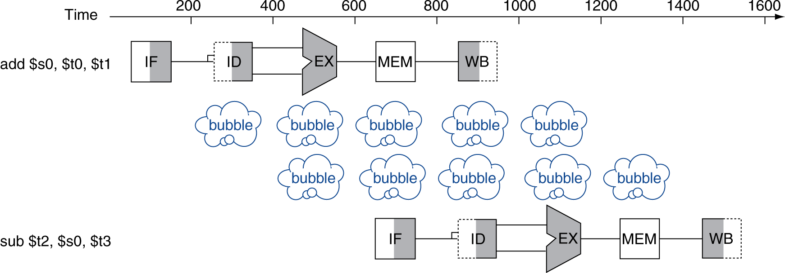
data hazards
An instruction depends on completion of data access by a previous instruction
add $s0, $t0, $t1 sub $t2, $s0, $t3

Slide 30
general framework of data hazards
Range and Domain of Instructions
D(i): domain of i = all values read by I prior to execution
R(i): range of instruction i = all values written by I, after execution
Read After Write (RAW), true, or dataflow, dependence
i: add r1, r2, r3
j: add r4, r1, r5
Write After Read (WAR), anti dependence
i: add r1, r2, r3
j: add r2, r4, r5
Write After Write (WAW), output dependence
i: add r1, r2, r3
j: add r1, r4, r5
RAW: R(i) ∩ D(j) ¬ = ∅
WAR: D(i) ∩ R(j) ¬ = ∅
WAW: R(i) ∩ R(j) ¬ = ∅

Slide 31
WAR & WAW
WAR & WAW are name dependencies
Dependence is on the container’s name not on the value contained.
Can be eliminated by renaming, static (in software) or dynamic (in hardware)
WAW & WAR cannot occur in the 5-stage pipeline
All the writing happens in WB stage, in order issue of all instructions
IF
ID
EX
MEM
WB
IF
ID
EX
MEM
WB
IF
ID
EX
MEM
WB

Slide 32
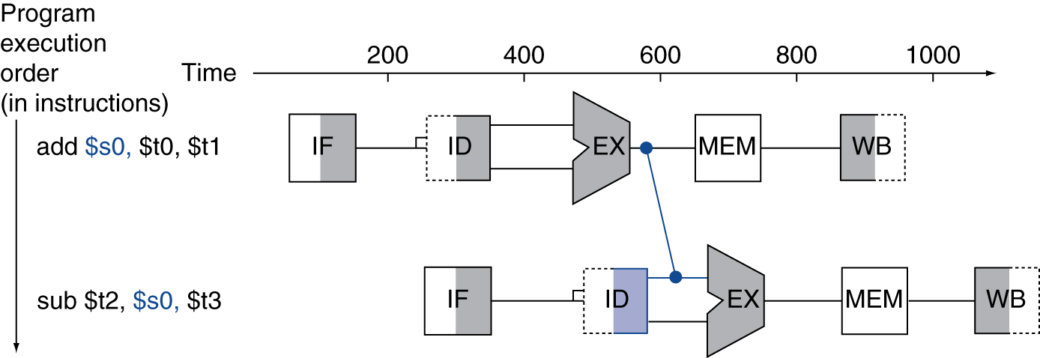
forwarding (or bypassing)
Use result when it is computed
Don’t wait for it to be stored in a register
Requires extra connections in the datapath

Slide 33
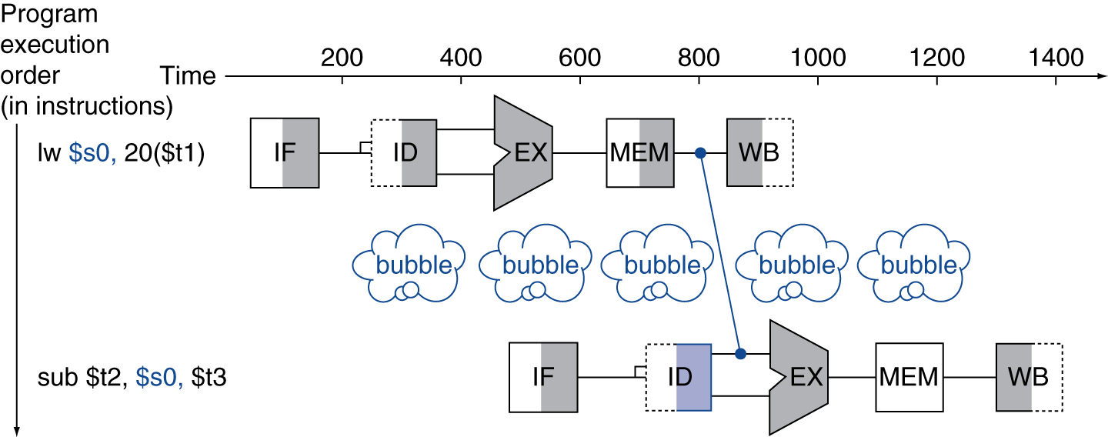
Load-use data hazard
Can’t always avoid stalls by forwarding
If value not computed when needed
Can’t forward backward in time!

Slide 34
code scheduling to avoid stalls
Reorder code to avoid use of load result in the next instruction
C code for A = B + E; C = B + F;
Reordering is commonly done by modern compilers
lw $t1, 0($t0)
lw $t2, 4($t0)
add $t3, $t1, $t2
sw $t3, 12($t0)
lw $t4, 8($t0)
add $t5, $t1, $t4
sw $t5, 16($t0)
lw $t1, 0($t0)
lw $t2, 4($t0)
lw $t4, 8($t0)
add $t3, $t1, $t2
sw $t3, 12($t0)
add $t5, $t1, $t4
sw $t5, 16($t0)
stall
stall
13 cycles
11 cycles

Slide 35
control hazards
Branch determines flow of control
Fetching next instruction depends on branch outcome
Pipeline can’t always fetch correct instruction
Still working on ID stage of branch
In MIPS pipeline
Need to compare registers and compute target early in the pipeline
Add hardware to do it in ID stage

Slide 36
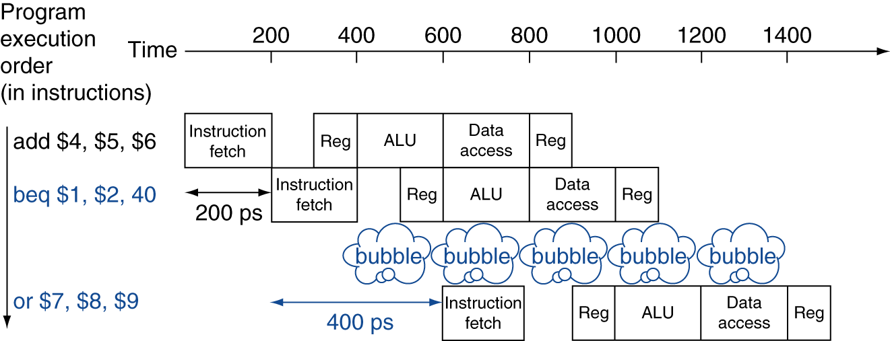
stall on branch
Wait until branch outcome determined before fetching next instruction
 | 1 | 2 | 3 | 4 | 5 | 6 | 7 | 8 | 9
add $4, $5, $6 | F | D | X | M | W
beq $1, $2, 40 |  | F | D | X | M | W
or $7, $8, $9 |  |  | - | - | F | D | X | M | W

Slide 37
branch prediction
Longer pipelines can’t readily determine branch outcome early
Stall penalty becomes unacceptable
Predict outcome of branch
Only stall if prediction is wrong
In MIPS pipeline
Can predict branches not taken
Fetch instruction after branch, with no delay

Slide 38
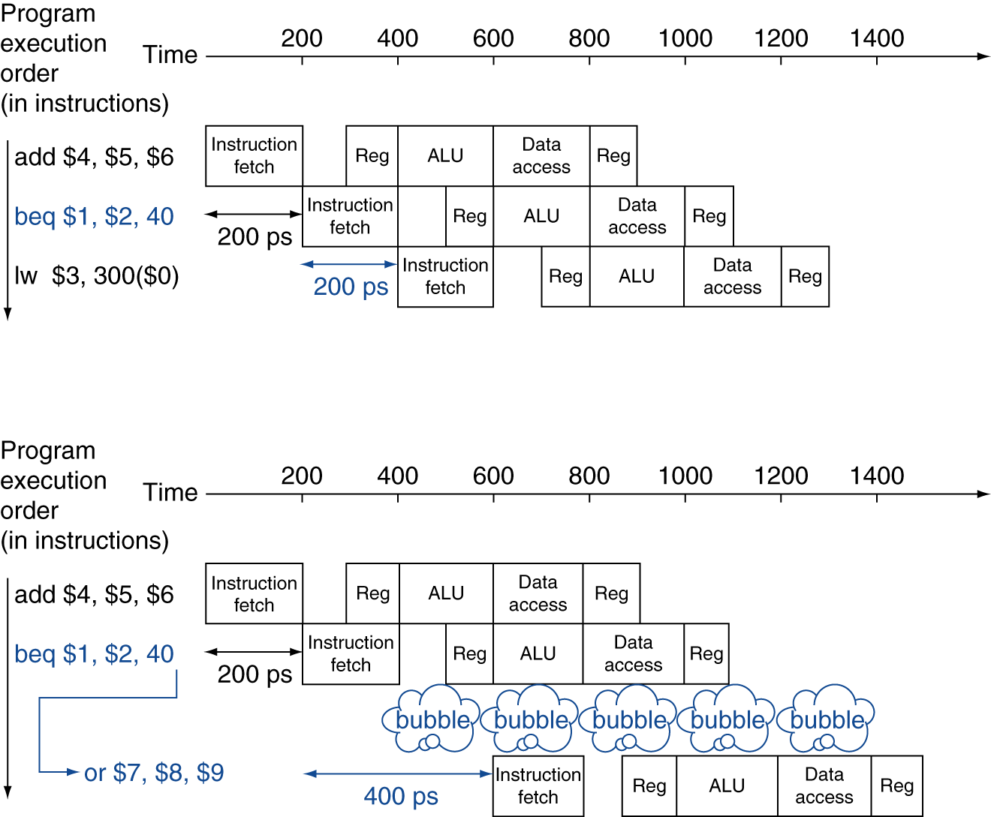
MIPS with predict not-taken
Prediction correct
Prediction incorrect

Slide 39
MIPS with predict not-taken
Prediction correct
 | 1 | 2 | 3 | 4 | 5 | 6 | 7 | 8 | 9
add $4, $5, $6 | F | D | X | M | W
beq $1, $2, 40 |  | F | D | X | M | W
lw $3, 300($0) |  |  | F | D | X | M | W
Prediction not correct
 | 1 | 2 | 3 | 4 | 5 | 6 | 7 | 8 | 9
add $4, $5, $6 | F | D | X | M | W
beq $1, $2, 40 |  | F | D | X | M | W
---------
or $7, $8, $9 |  |  | - | - | F | D | X | M | W

Slide 40
More-Realistic Branch Prediction
Static branch prediction
Based on typical branch behavior
Example: loop and if-statement branches
Predict backward branches taken
Predict forward branches not taken
Dynamic branch prediction
Hardware measures actual branch behavior
e.g., record recent history of each branch
Assume future behavior will continue the trend
When wrong, stall while re-fetching, and update history

Slide 41
Pipeline Summary
The BIG Picture
Pipelining improves performance by increasing instruction throughput
Executes multiple instructions in parallel
Each instruction has the same latency
Subject to hazards
Structure, data, control
Instruction set design affects complexity of pipeline implementation

Slide 42
data hazards in ALU instructions
Consider this sequence:
sub $2, $1,$3 and $12,$2,$5 or $13,$6,$2 add $14,$2,$2 sw $15,100($2)
We can resolve hazards with forwarding
How do we detect when to forward?

Slide 43
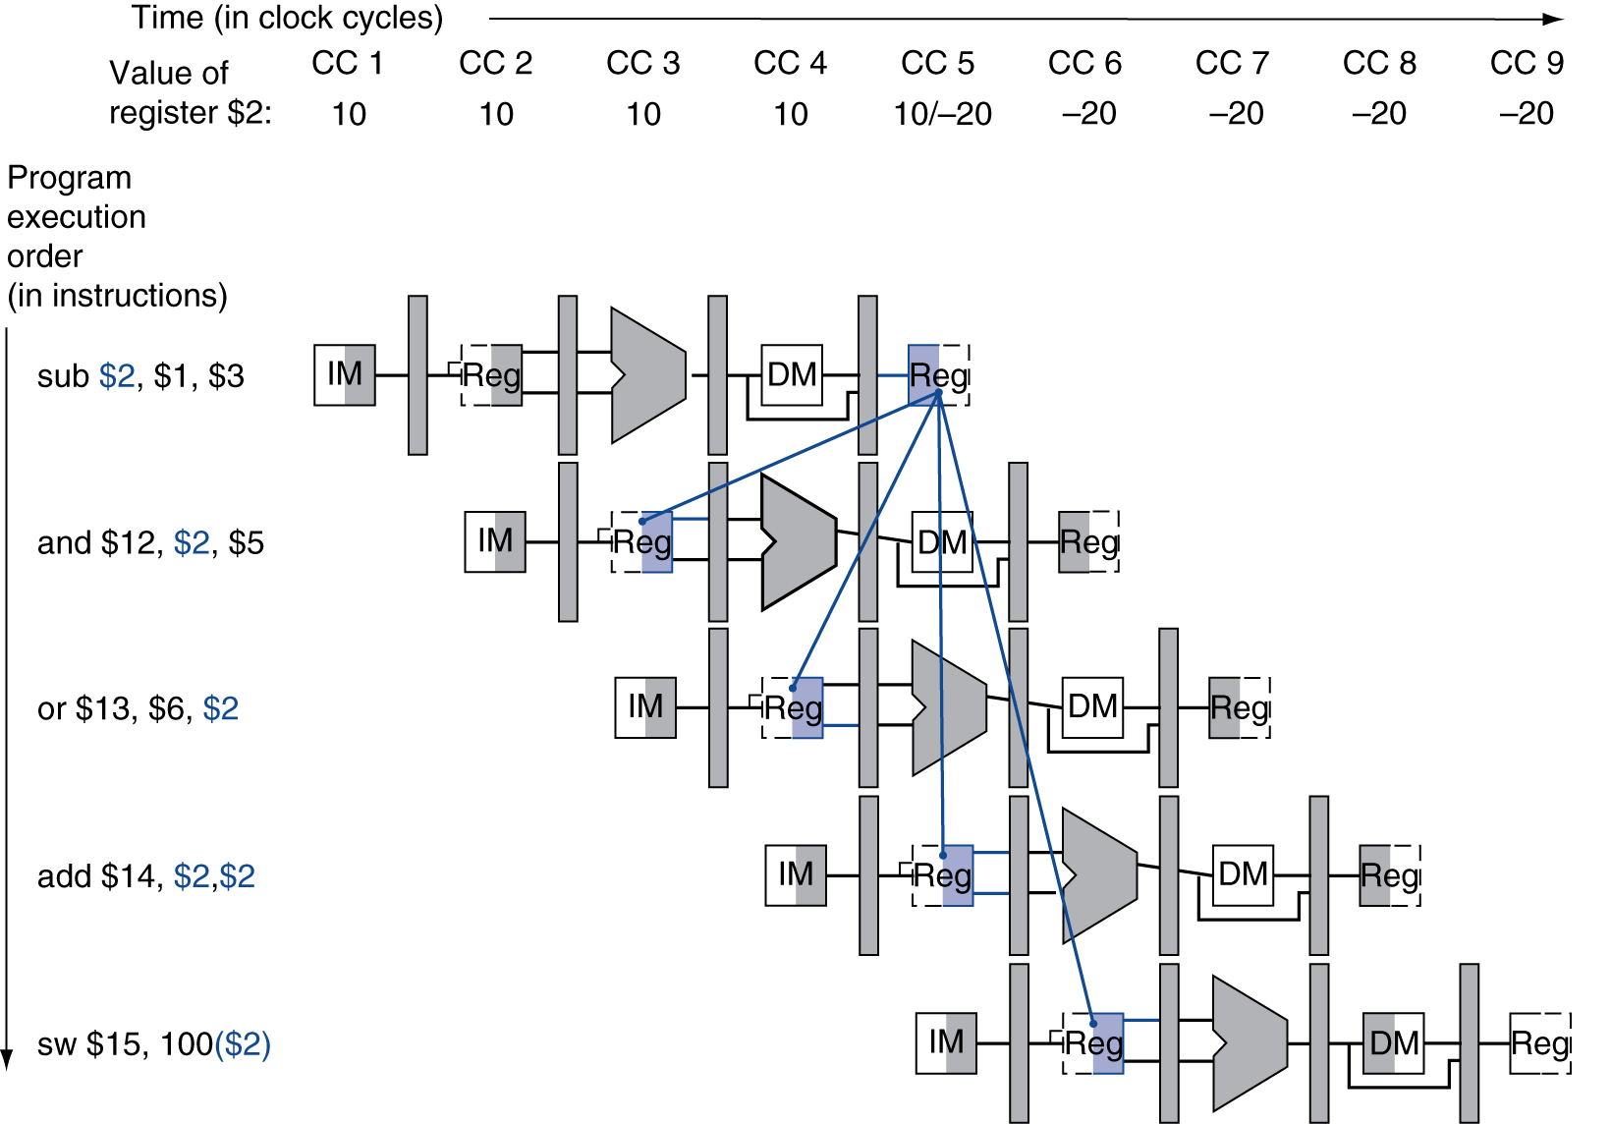
dependencies & forwarding
= Forwarding

Slide 44
detecting the need to forward
Pass register numbers along pipeline
e.g., ID/EX.RegisterRs = register number for Rs sitting in ID/EX pipeline register
ALU operand register numbers in EX stage are given by
ID/EX.RegisterRs, ID/EX.RegisterRt
Data hazards when
1a. EX/MEM.RegisterRd = ID/EX.RegisterRs
1b. EX/MEM.RegisterRd = ID/EX.RegisterRt
2a. MEM/WB.RegisterRd = ID/EX.RegisterRs
2b. MEM/WB.RegisterRd = ID/EX.RegisterRt
If dest == either src register
Fwd from EX/MEM pipeline reg
If dest == src register
Fwd from MEM/WB pipeline reg

Slide 45
detecting the need to forward
But only if forwarding instruction will write to a register!
EX/MEM.RegWrite, MEM/WB.RegWrite
And only if Rd for that instruction is not $zero
EX/MEM.RegisterRd ≠ 0, MEM/WB.RegisterRd ≠ 0

Slide 46
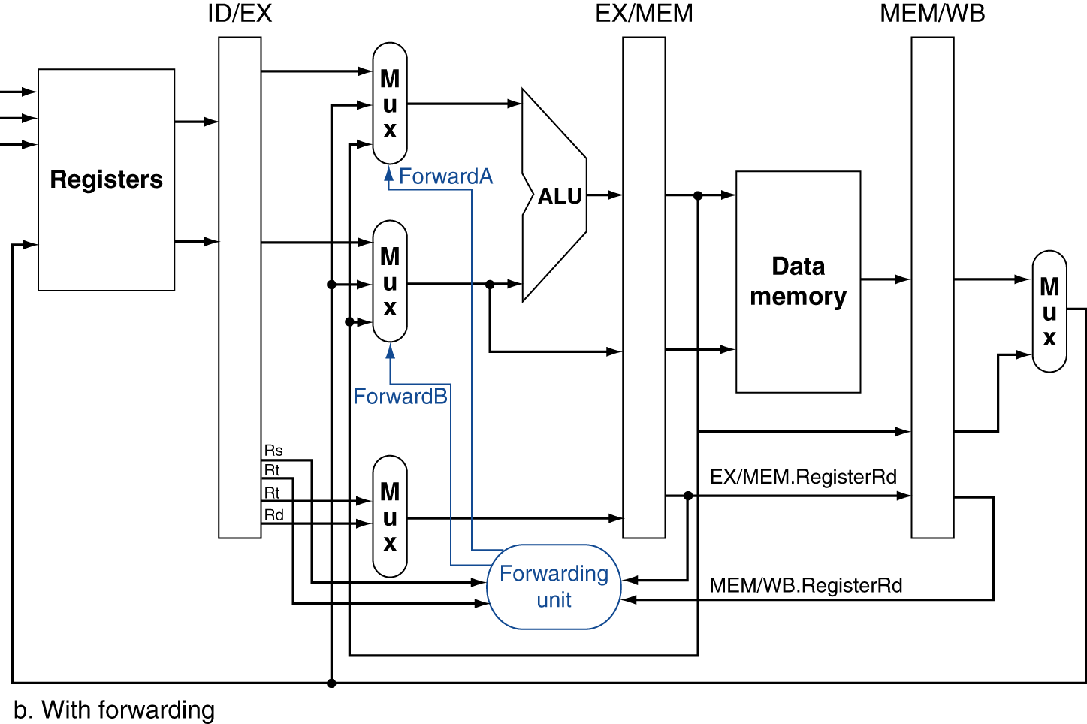
forwarding paths

Slide 47
forwarding conditions
EX hazard
if (EX/MEM.RegWrite and (EX/MEM.RegisterRd ≠ 0) and (EX/MEM.RegisterRd = ID/EX.RegisterRs)) ForwardA = 10
if (EX/MEM.RegWrite and (EX/MEM.RegisterRd ≠ 0) and (EX/MEM.RegisterRd = ID/EX.RegisterRt)) ForwardB = 10
MEM hazard
if (MEM/WB.RegWrite and (MEM/WB.RegisterRd ≠ 0) and (MEM/WB.RegisterRd = ID/EX.RegisterRs)) ForwardA = 01
if (MEM/WB.RegWrite and (MEM/WB.RegisterRd ≠ 0) and (MEM/WB.RegisterRd = ID/EX.RegisterRt)) ForwardB = 01

Slide 48
double data hazard
Consider the sequence:
add $1,$1,$2
add $1,$1,$3
add $1,$1,$4
Both hazards occur
Want to use the most recent
Revise MEM hazard condition
Only fwd if EX hazard condition isn’t true

Slide 49
revised forwarding condition
MEM hazard
if (MEM/WB.RegWrite and (MEM/WB.RegisterRd ≠ 0) and not (EX/MEM.RegWrite and (EX/MEM.RegisterRd ≠ 0) and (EX/MEM.RegisterRd = ID/EX.RegisterRs)) and (MEM/WB.RegisterRd = ID/EX.RegisterRs)) ForwardA = 01
if (MEM/WB.RegWrite and (MEM/WB.RegisterRd ≠ 0) and not (EX/MEM.RegWrite and (EX/MEM.RegisterRd ≠ 0) and (EX/MEM.RegisterRd = ID/EX.RegisterRt)) and (MEM/WB.RegisterRd = ID/EX.RegisterRt)) ForwardB = 01

Slide 50
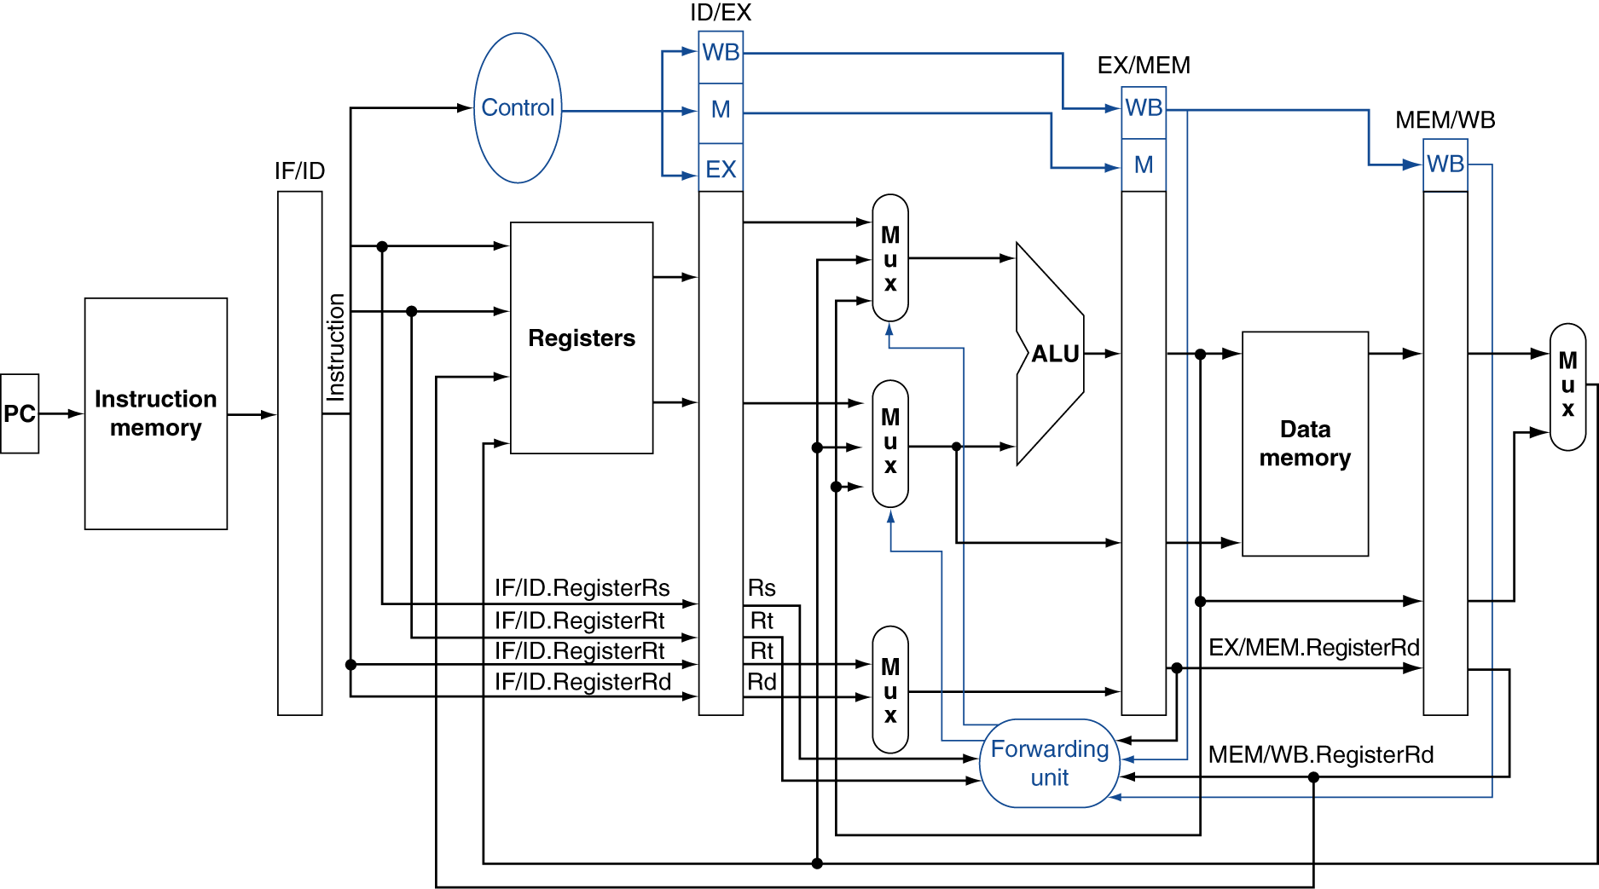
datapath with forwarding

Slide 51
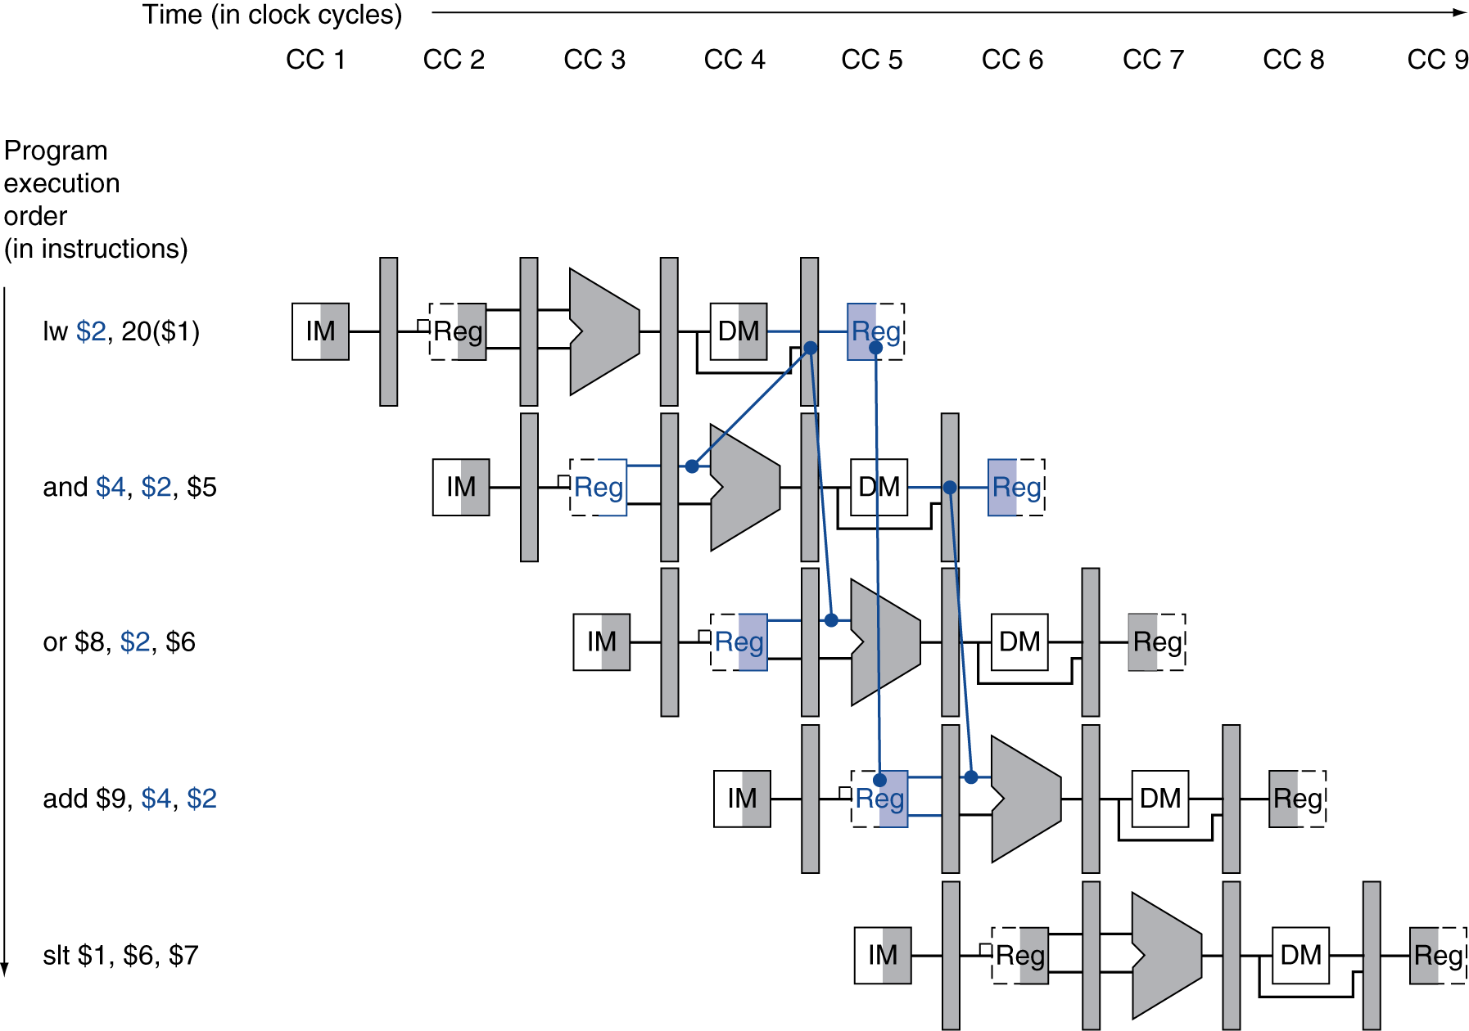
Load-use data hazard
Need to stall for one cycle

Slide 52
Load-use hazard detection
Check when using instruction is decoded in ID stage
ALU operand register numbers in ID stage are given by
IF/ID.RegisterRs, IF/ID.RegisterRt
Load-use hazard when
ID/EX.MemRead and ((ID/EX.RegisterRt = IF/ID.RegisterRs) or (ID/EX.RegisterRt = IF/ID.RegisterRt))
If detected, stall and insert bubble

Slide 53
how to stall the pipeline
Force control values in ID/EX register to 0
EX, MEM and WB do nop (no-operation)
Prevent update of PC and IF/ID register
Current instruction is decoded again
Following instruction is fetched again
1-cycle stall allows MEM to read data for lw
Can subsequently forward to EX stage

Slide 54
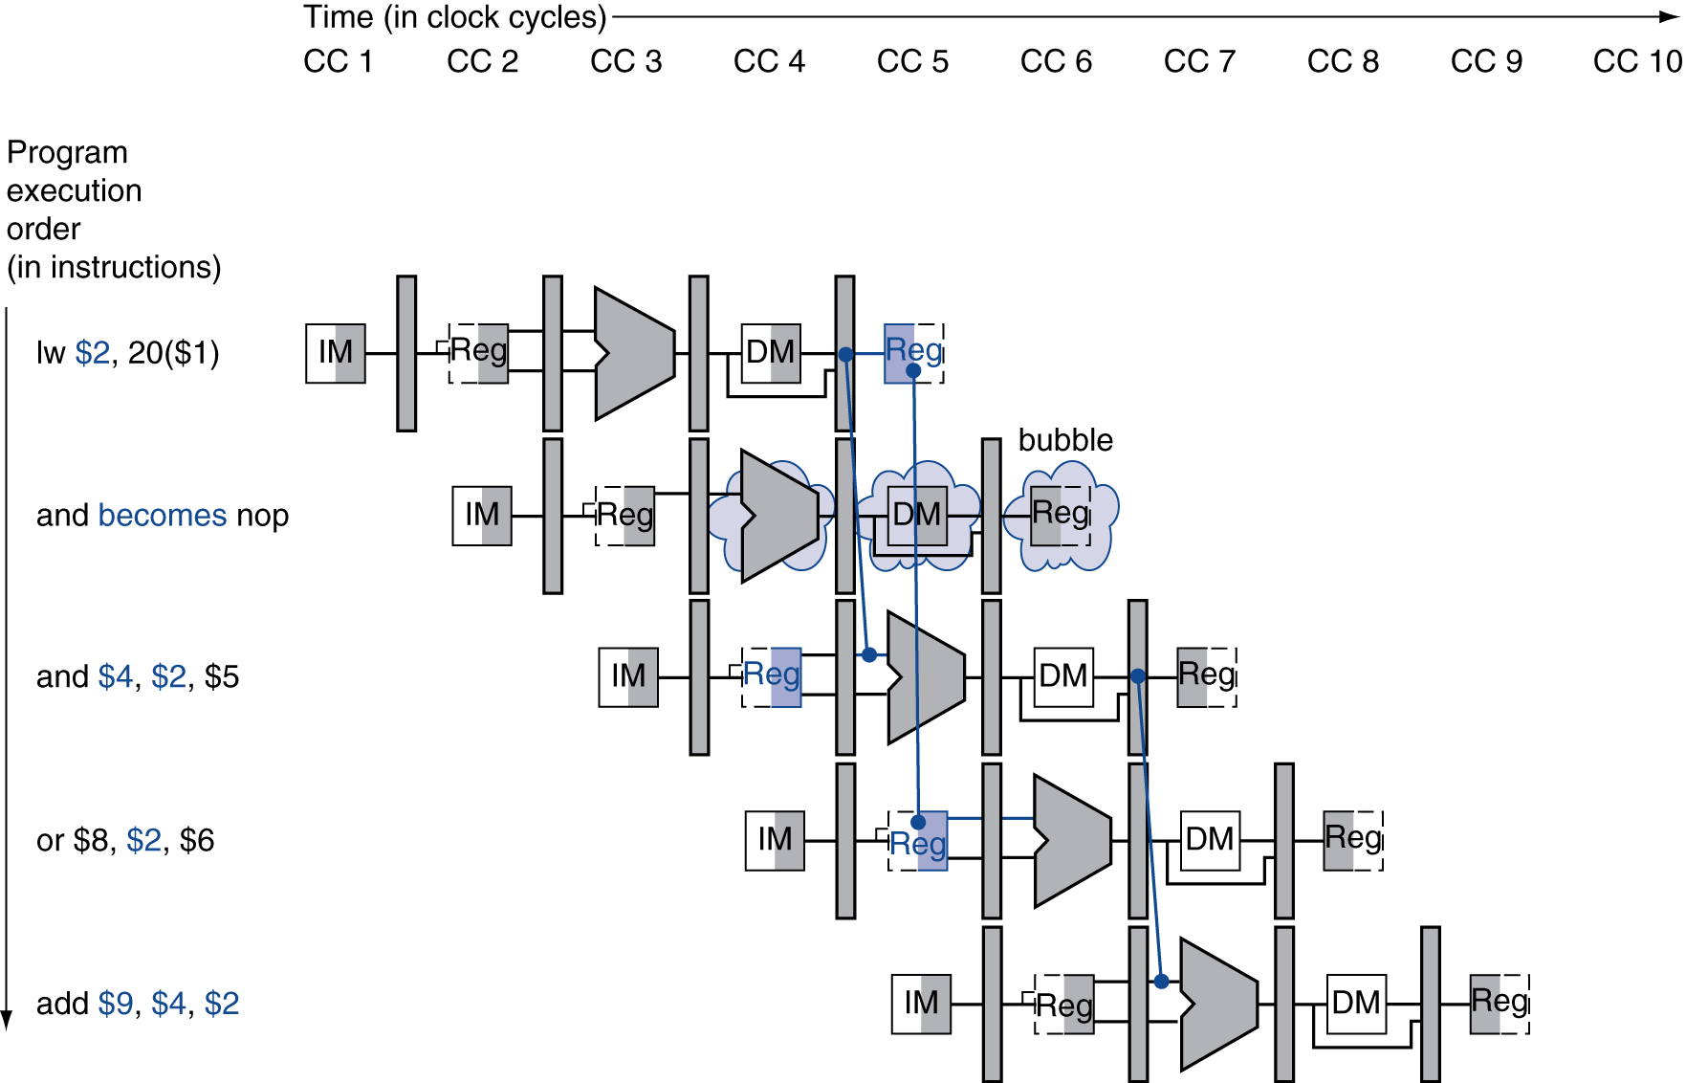
stall/bubble in the pipeline
Stall inserted here

Slide 55
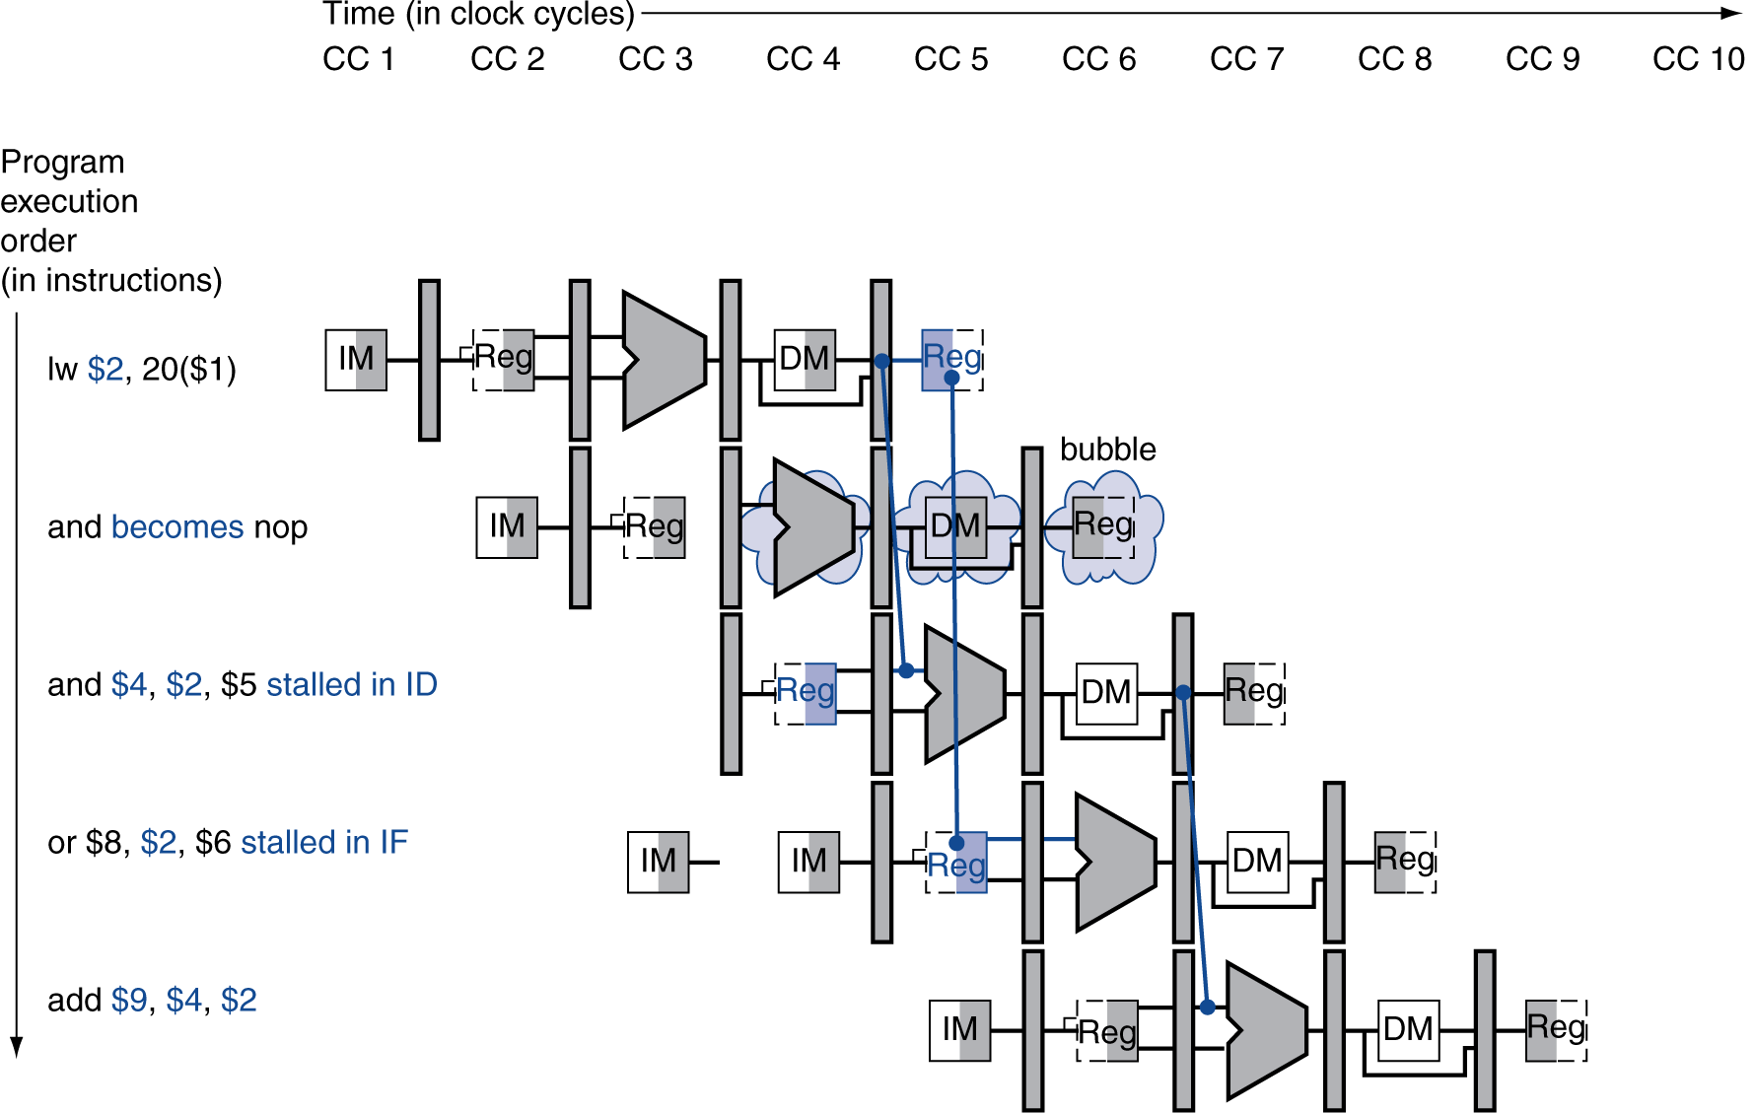
stall/bubble in the pipeline
Or, more accurately…

Slide 56
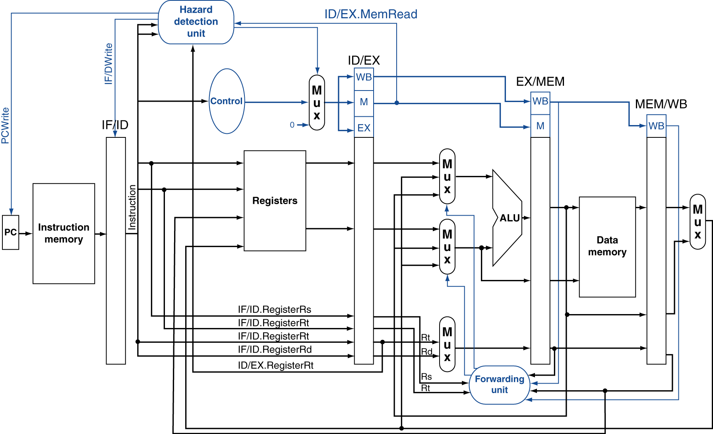
datapath with hazard detection

Slide 57
stalls and performance
The BIG Picture
Stalls reduce performance
But are required to get correct results
Compiler can arrange code to avoid hazards and stalls
Requires knowledge of the pipeline structure

Slide 58
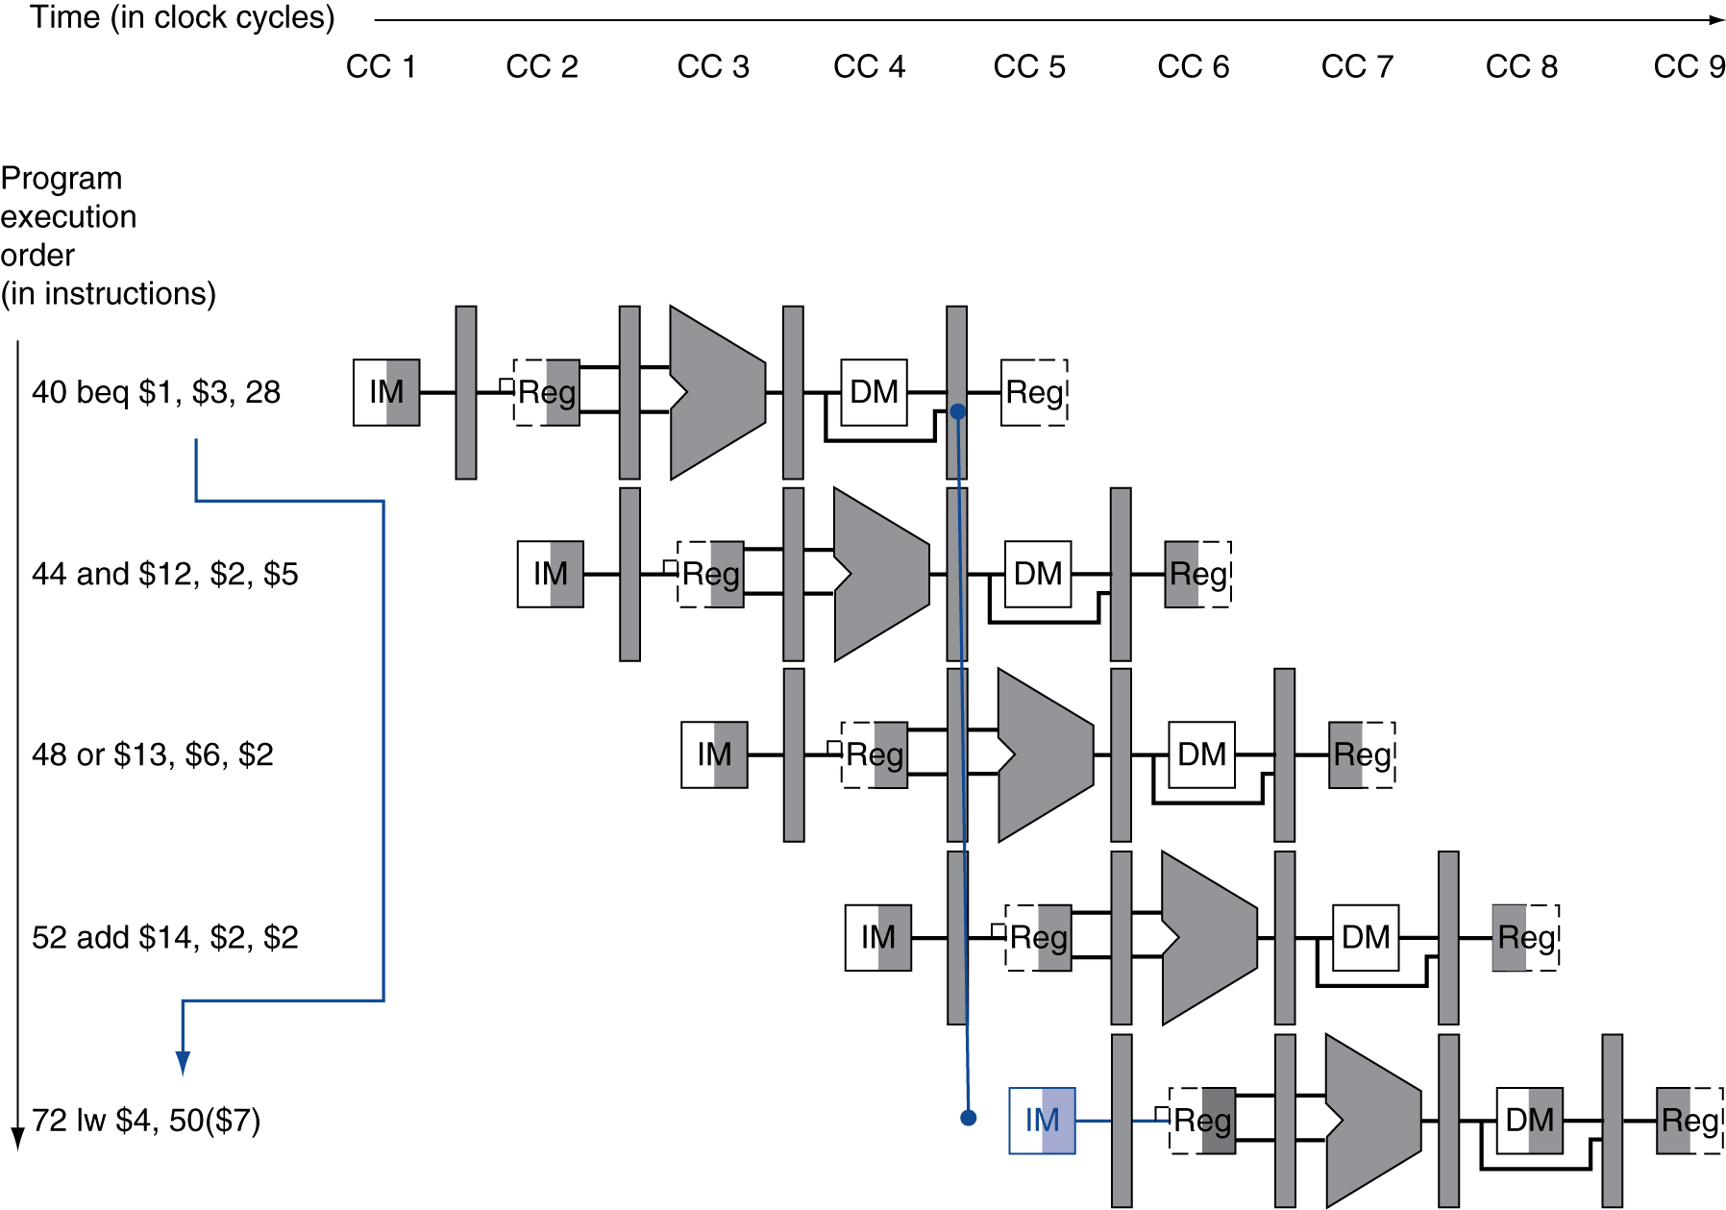
branch hazards
If branch outcome determined in MEM
Flush these instructions
(Set control values to 0)
PC

Slide 59
reducing branch delay
Move hardware to determine outcome to ID stage
Target address adder
Register comparator
Example: branch taken
36: sub $10, $4, $8
40: beq $1, $3, 7
44: and $12, $2, $5
48: or $13, $2, $6
52: add $14, $4, $2
56: slt $15, $6, $7 ……………………
72: lw $4, 50($7)

Slide 60
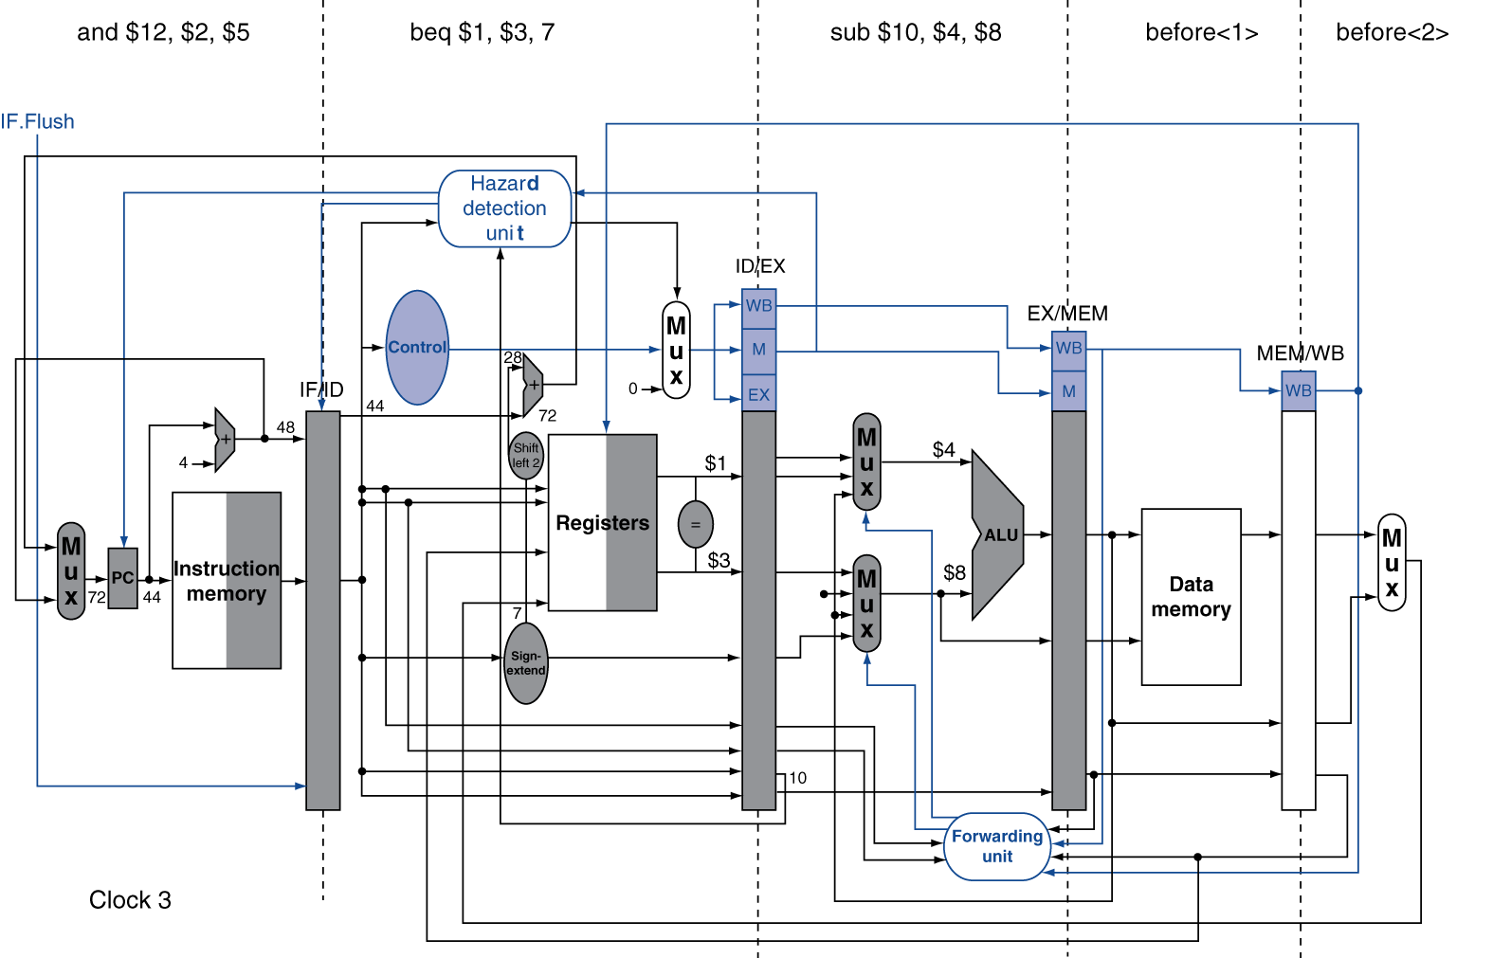
example: branch taken

Slide 61
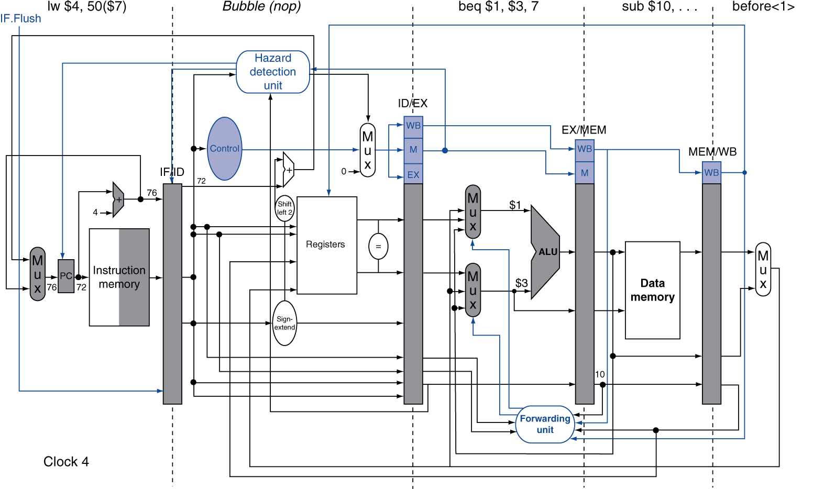
example: branch taken

Slide 62
data hazards for branches
If a comparison register is a destination of 2nd or 3rd preceding ALU instruction
add $1, $2, $3
IF
ID
EX
MEM
WB
add $4, $5, $6
IF
ID
EX
MEM
WB
…
IF
ID
EX
MEM
WB
beq $1, $4, target
IF
ID
EX
MEM
WB
Resolve using forwarding

Slide 63
data hazards for branches
If a comparison register is a destination of preceding ALU instruction or 2nd preceding load instruction
Need 1 stall cycle
lw $1, addr
IF
ID
EX
MEM
WB
add $4, $5, $6
IF
ID
EX
MEM
WB
beq stalled
IF
ID
beq $1, $4, target
ID
EX
MEM
WB

Slide 64
data hazards for branches
If a comparison register is a destination of immediately preceding load instruction
Need 2 stall cycles
lw $1, addr
IF
ID
EX
MEM
WB
beq stalled
IF
ID
beq stalled
ID
beq $1, $0, target
ID
EX
MEM
WB

Slide 65
example 1
No Forwarding
Inst | 1 | 2 | 3 | 4 | 5 | 6 | 7 | 8 | 9 | 10 | 11 | 12 | 13 | 14 | 15 | 16 | Stall cycles
lw $3, 0($1) | F | D | X | M | W |  |  |  |  |  |  |  |  |  |  |  | 0
add $4, $3, $9 |  | F | - | - | D | X | M | W |  |  |  |  |  |  |  |  | 2
add $5, $4, $9 |  |  | - | - | F | - | - | D | X | M | W |  |  |  |  |  | 2
beq $5, $4, label |  |  |  |  |  |  | - | F | - | - | D | X | M | W |  |  | 2
Forwarding
Inst | 1 | 2 | 3 | 4 | 5 | 6 | 7 | 8 | 9 | 10 | 11 | 12 | 13 | 14 | 15 | 16 | Stall cycles
lw $3, 0($1) | F | D | X | M | W |  |  |  |  |  |  |  |  |  |  |  | 0
add $4, $3, $9 |  | F | D | - | X | M | W |  |  |  |  |  |  |  |  |  | 1
add $5, $4, $9 |  |  | F | - | D | X | M | W |  |  |  |  |  |  |  |  | 0
beq $5, $4, label |  |  |  |  | F | D | X | M | W |  |  |  |  |  |  |  | 0

Slide 66
example 2
Branch NOT Taken - With Forwarding
Inst | 1 | 2 | 3 | 4 | 5 | 6 | 7 | 8 | 9 | 10 | 11 | 12 | 13 | 14 | 15 | 16 | Stall cycles
lw $1, 0($3) | F | D | X | M | W |  |  |  |  |  |  |  |  |  |  |  | 0
add $4, $5, $6 |  | F | D | X | M | W |  |  |  |  |  |  |  |  |  |  | 0
beq $1, $4, label |  |  | F | D | X | M | W |  |  |  |  |  |  |  |  |  | 0
sub $7,$8,$9 |  |  |  | F | D | X | M | W |  |  |  |  |  |  |  |  | 0
Branch Taken - With Forwarding
Inst | 1 | 2 | 3 | 4 | 5 | 6 | 7 | 8 | 9 | 10 | 11 | 12 | 13 | 14 | 15 | 16 | Stall cycles
lw $1, 0($3) | F | D | X | M | W |  |  |  |  |  |  |  |  |  |  |  | 0
add $4, $5, $6 |  | F | D | X | M | W |  |  |  |  |  |  |  |  |  |  | 0
beq $1, $4, label |  |  | F | D | X | M | W |  |  |  |  |  |  |  |  |  | 0
sub $7,$8,$9 |  |  |  | F | D |  |  |  |  |  |  |  |  |  |  |  | 2
………..
label: |  |  |  |  |  | F | D | X | M | W |  |  |  |  |  |  | 0

Slide 67
dynamic branch prediction
In deeper and superscalar pipelines, branch penalty is more significant
Use dynamic prediction
Branch prediction buffer (aka branch history table)
Indexed by recent branch instruction addresses
Stores outcome (taken/not taken)
To execute a branch
Check table, expect the same outcome
Start fetching from fall-through or target
If wrong, flush pipeline and flip prediction

Slide 68
1-bit predictor: shortcoming
Inner loop branches mispredicted twice!
outer: … … inner: …
…
beq …, …, inner … beq …, …, outer
Mispredict as taken on last iteration of inner loop
Then mispredict as not taken on first iteration of inner loop next time around

Slide 69
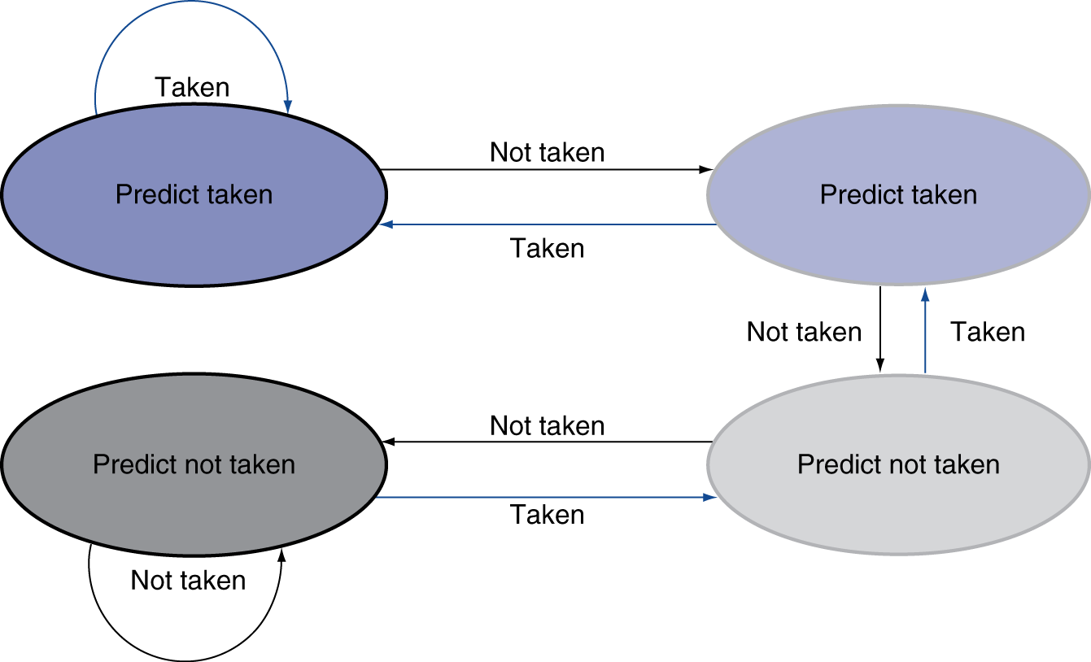
2-bit predictor
Only change prediction on two successive mispredictions

Slide 70
calculating the branch target
Even with predictor, still need to calculate the target address
1-cycle penalty for a taken branch
Branch target buffer (BTB)
Cache of target addresses
Indexed by PC when instruction fetched
If hit and instruction is branch predicted taken, can fetch target immediately

Slide 71
exceptions and interrupts
“Unexpected” events requiring change in flow of control
Different ISAs use the terms differently
Exception
Arises within the CPU
e.g., undefined opcode, overflow, syscall, …
Interrupt
From an external I/O controller
Dealing with them without sacrificing performance is hard

Slide 72
handling exceptions
In MIPS, exceptions managed by a System Control Coprocessor (CP0)
Save PC of offending (or interrupted) instruction
In MIPS: Exception Program Counter (EPC)
Save indication of the problem
In MIPS: Cause register
We’ll assume 1-bit
0 for undefined opcode, 1 for overflow
Jump to handler at 8000 00180

Slide 73
an alternate mechanism
Vectored Interrupts
Handler address determined by the cause
Example:
Undefined opcode: C000 0000
Overflow: C000 0020
…: C000 0040
Instructions either
Deal with the interrupt, or
Jump to real handler

Slide 74
handler actions
Read cause, and transfer to relevant handler
Determine action required
If restartable
Take corrective action
use EPC to return to program
Otherwise
Terminate program
Report error using EPC, cause, …

Slide 75
exceptions in a pipeline
Another form of control hazard
Consider overflow on add in EX stage
add $1, $2, $1
Prevent $1 from being clobbered
Complete previous instructions
Flush add and subsequent instructions
Set Cause and EPC register values
Transfer control to handler
Similar to mispredicted branch
Use much of the same hardware

Slide 76
precise interrupt (or exception)
An interrupt is called precise if
all instructions preceding the interrupting instructions have completed when the interrupt is serviced
no subsequent instruction has started (including the interrupting one)
this means that
a precise interrupt maintains sequential consistency

Slide 77
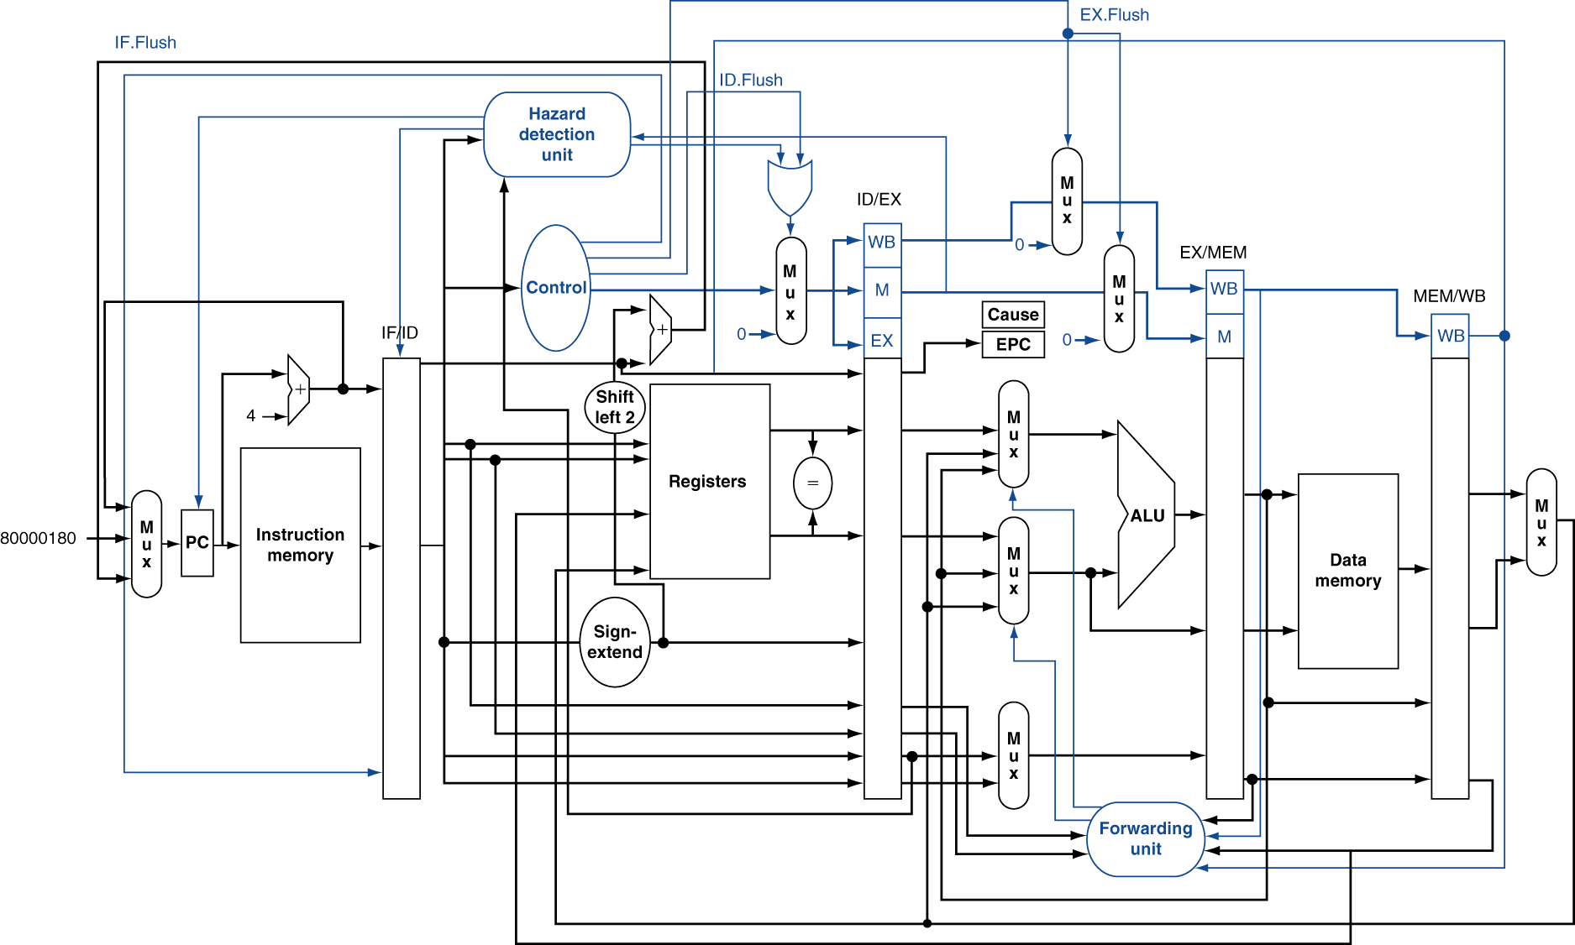
pipeline with exceptions

Slide 78
exception properties
Restartable exceptions
Pipeline can flush the instruction
Handler executes, then returns to the instruction
Refetched and executed from scratch
PC saved in EPC register
Identifies causing instruction
Actually PC + 4 is saved
Handler must adjust

Slide 79
exception example
Exception on add in
40 sub $11, $2, $4
44 and $12, $2, $5
48 or $13, $2, $6
4C add $1, $2, $1
50 slt $15, $6, $7
54 lw $16, 50($7)
…
Handler
80000180 sw $25, 1000($0)
80000184 sw $26, 1004($0)
…

Slide 80
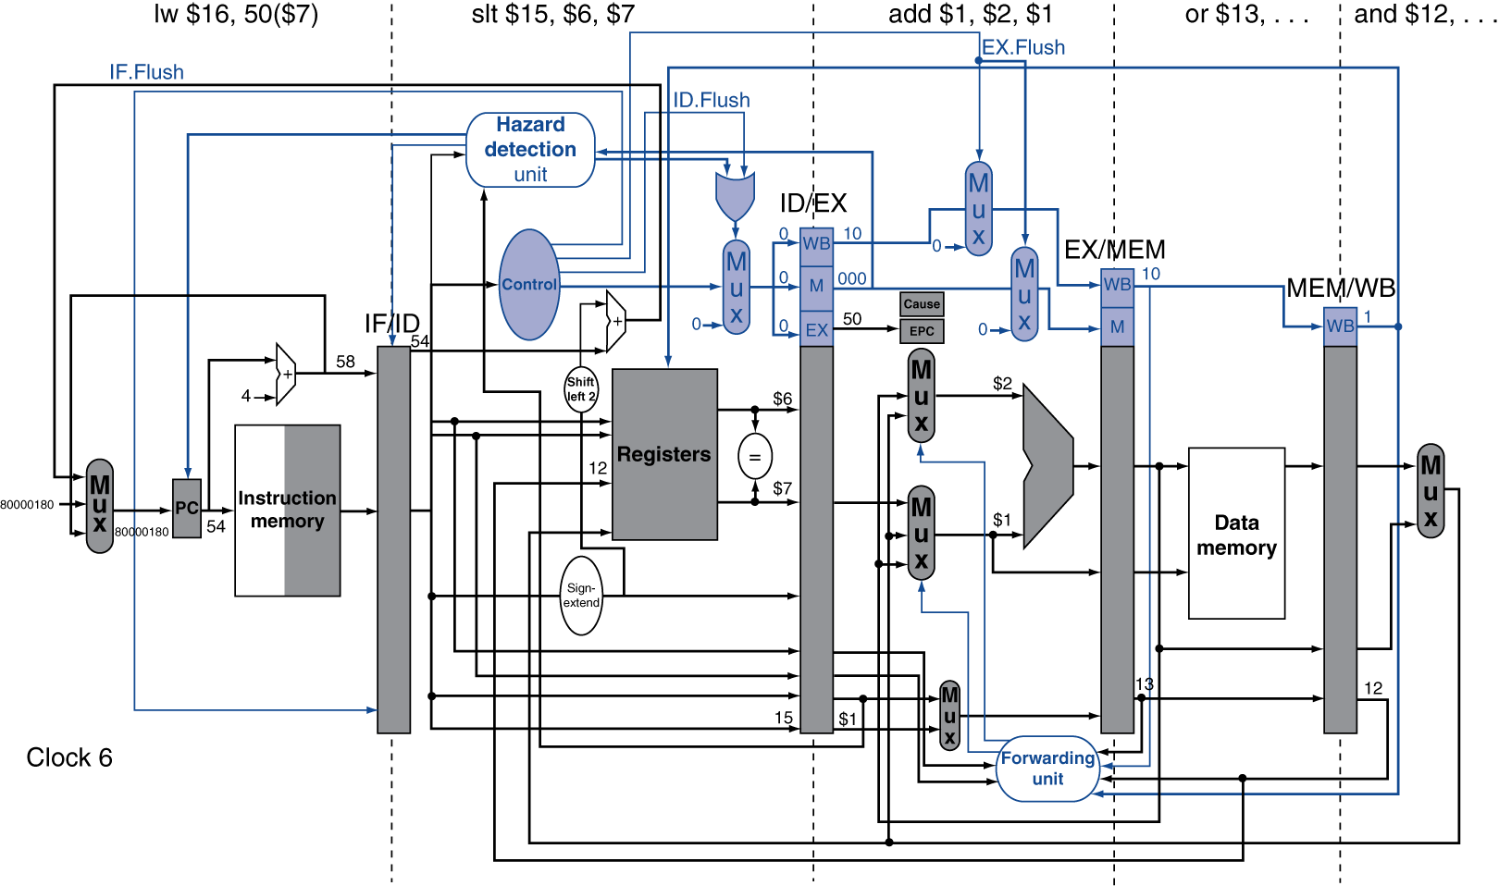
exception example

Slide 81
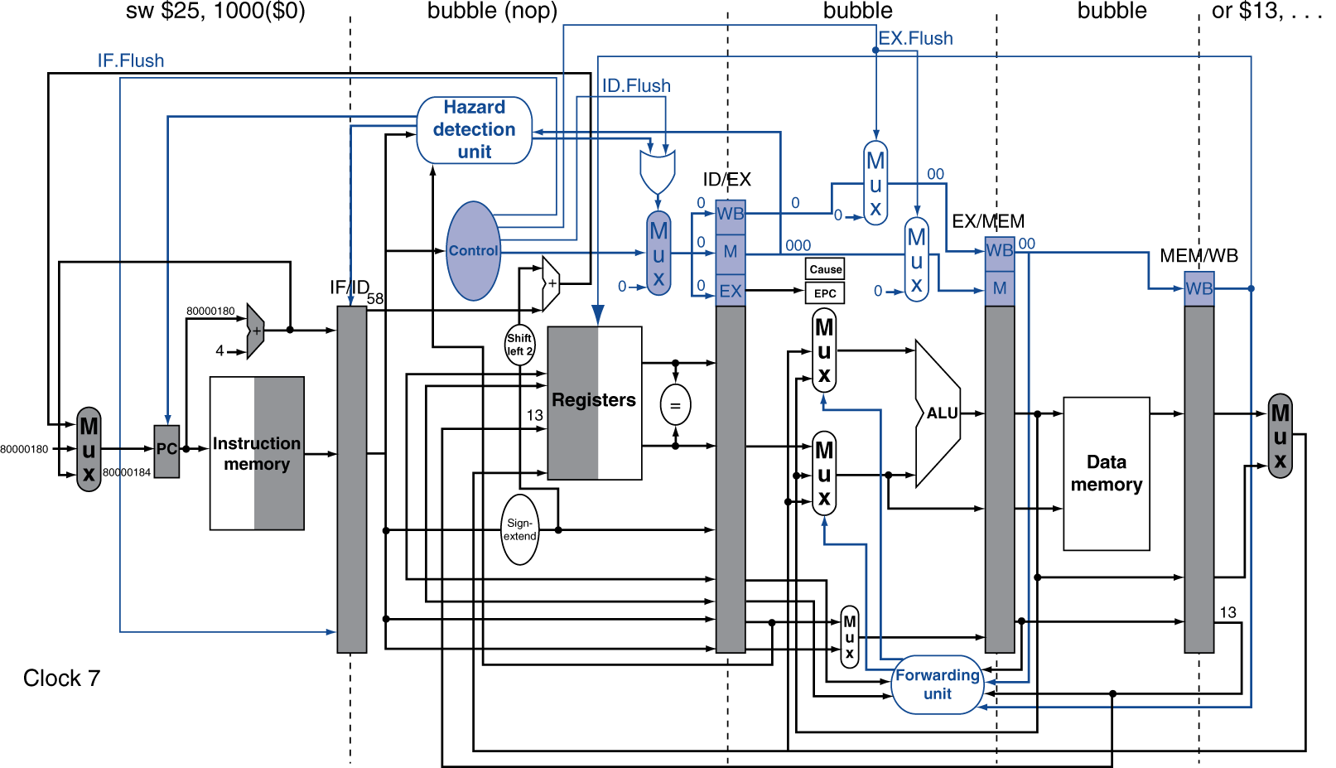
exception example

Slide 82
multiple exceptions
Pipelining overlaps multiple instructions
Could have multiple exceptions at once
Simple approach: deal with exception from earliest instruction
Flush subsequent instructions
“Precise” exceptions
In complex pipelines
Multiple instructions issued per cycle
Out-of-order completion
Maintaining precise exceptions is difficult!

Slide 83
imprecise exceptions
Just stop pipeline and save state
Including exception cause(s)
Let the handler work out
Which instruction(s) had exceptions
Which to complete or flush
May require “manual” completion
Simplifies hardware, but more complex handler software
Not feasible for complex multiple-issue out-of-order pipelines

Slide 84
Fallacies
Pipelining is easy (!)
The basic idea is easy
The devil is in the details
e.g., detecting data hazards
Pipelining is independent of technology
So why haven’t we always done pipelining?
More transistors make more advanced techniques feasible
Pipeline-related ISA design needs to take account of technology trends
e.g., predicated instructions

Slide 85
Pitfalls
Poor ISA design can make pipelining harder
e.g., complex instruction sets (VAX, IA-32)
Significant overhead to make pipelining work
IA-32 micro-op approach
e.g., complex addressing modes
Register update side effects, memory indirection
e.g., delayed branches
Advanced pipelines have long delay slots

Slide 86
Concluding Remarks
ISA influences design of datapath and control
Datapath and control influence design of ISA
Pipelining improves instruction throughput using parallelism
More instructions completed per second
Latency for each instruction not reduced
Hazards: structural, data, control
Multiple issue and dynamic scheduling (ILP)
Dependencies limit achievable parallelism
Complexity leads to the power wall

